Slide 1
PLASTBAU®
Advance Building Products company
شرکت فرآورده های پیشرفته ساختمانی
Partition
پارتیشن

Slide 2
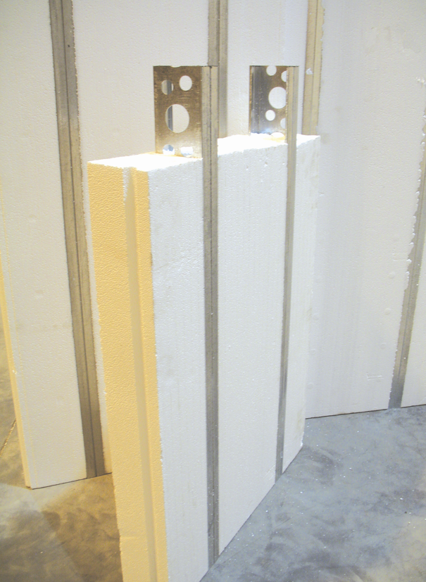
EASY&FAST INSTALLATION

Slide 3
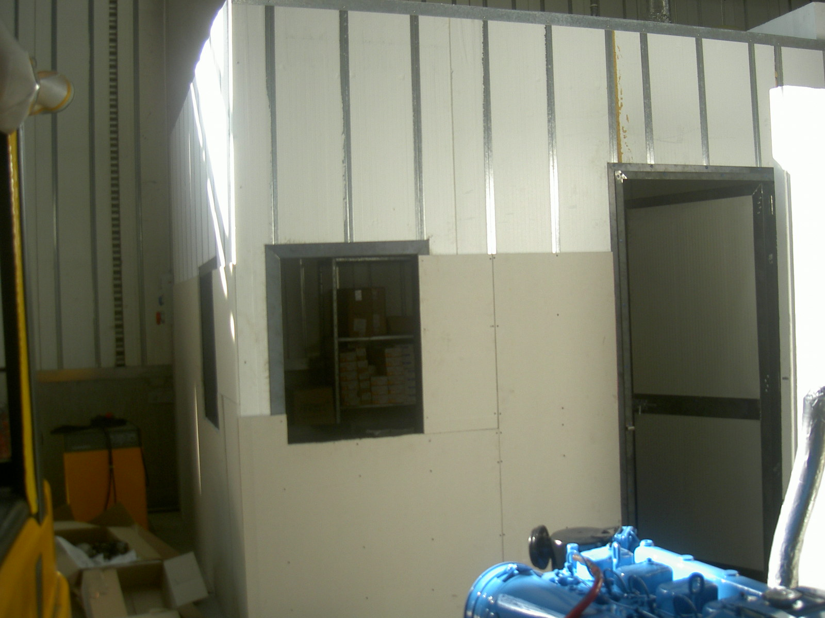
Qeshm 1386

Slide 4
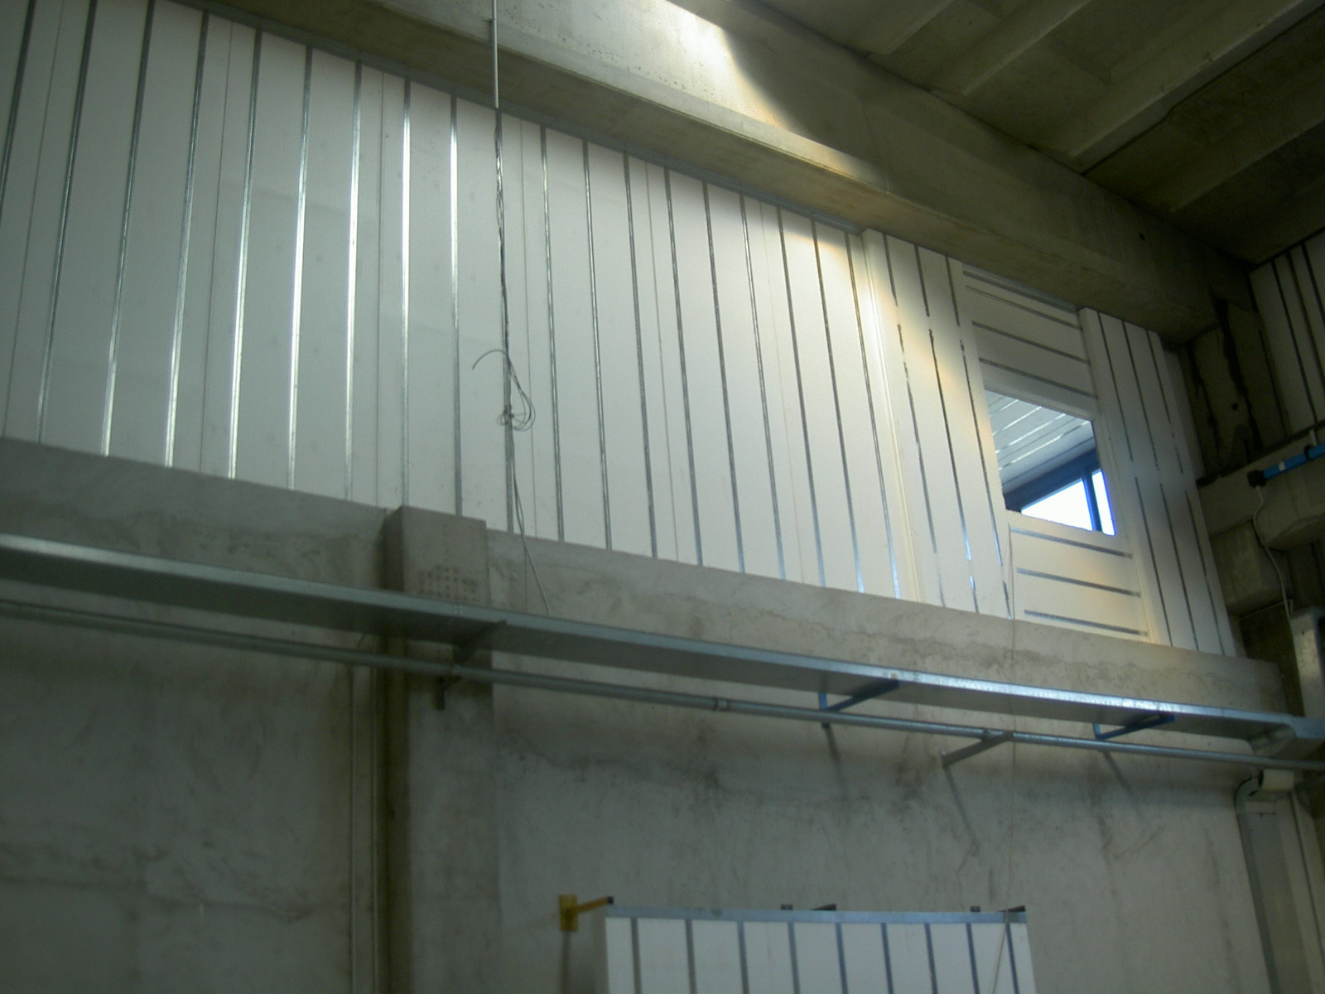
Qeshm 1386

Slide 5
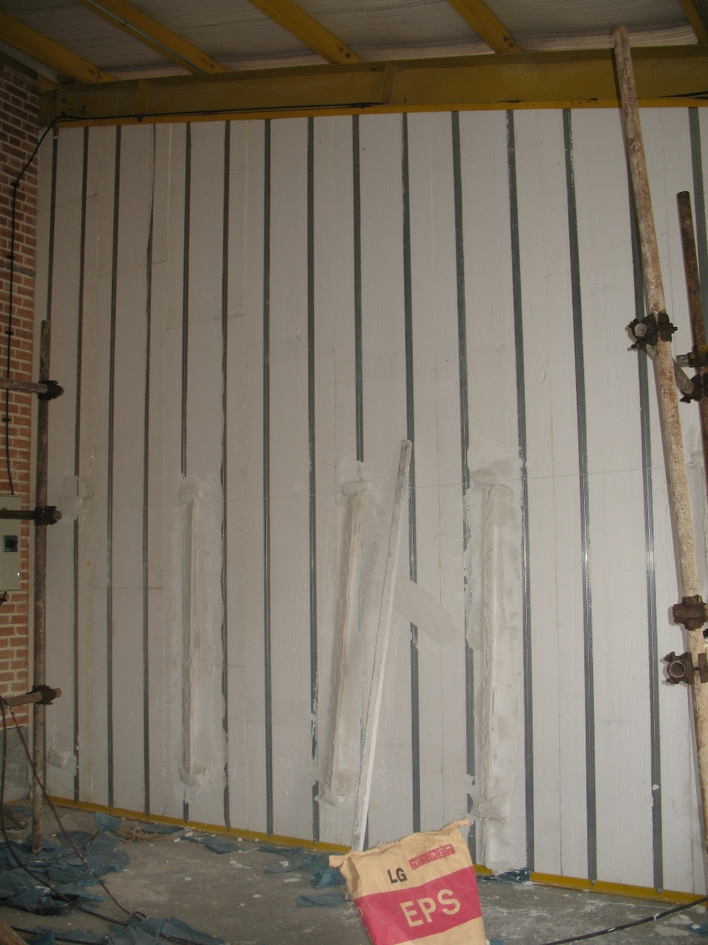
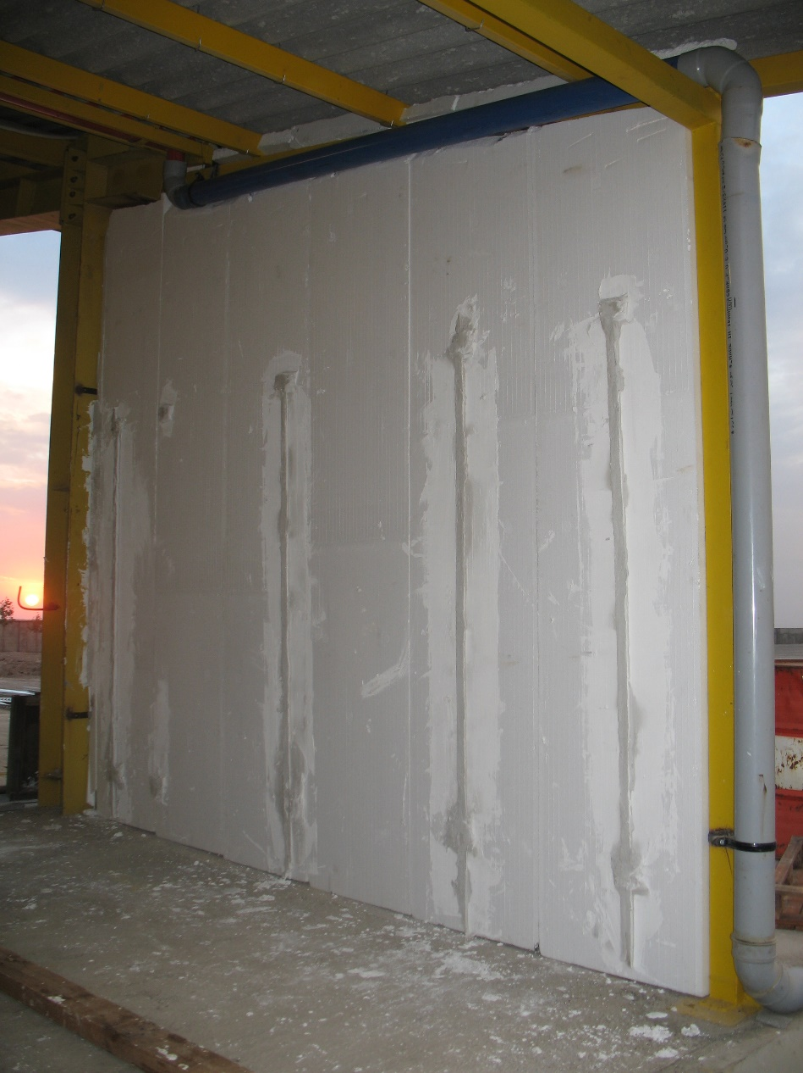
Qazvin 1386

Slide 6
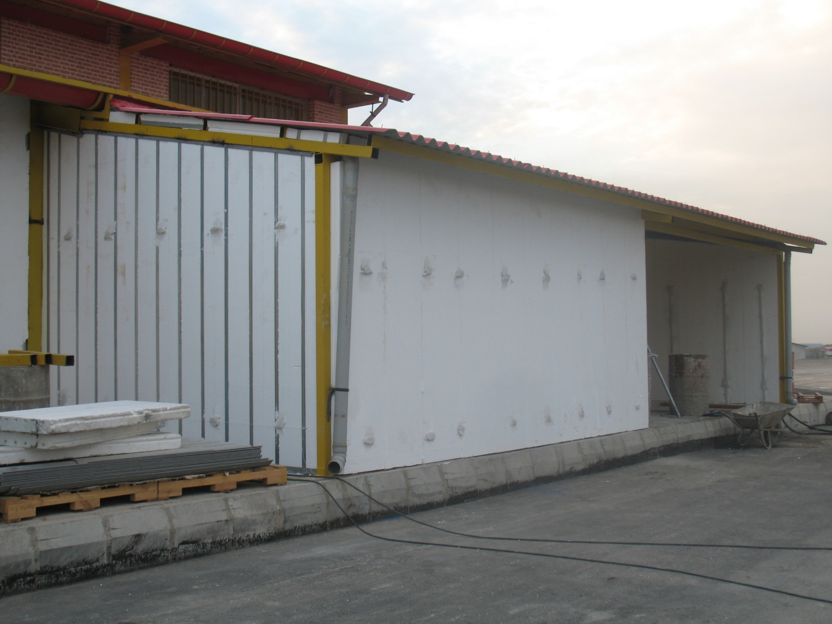
Qazvin 1386

Slide 7
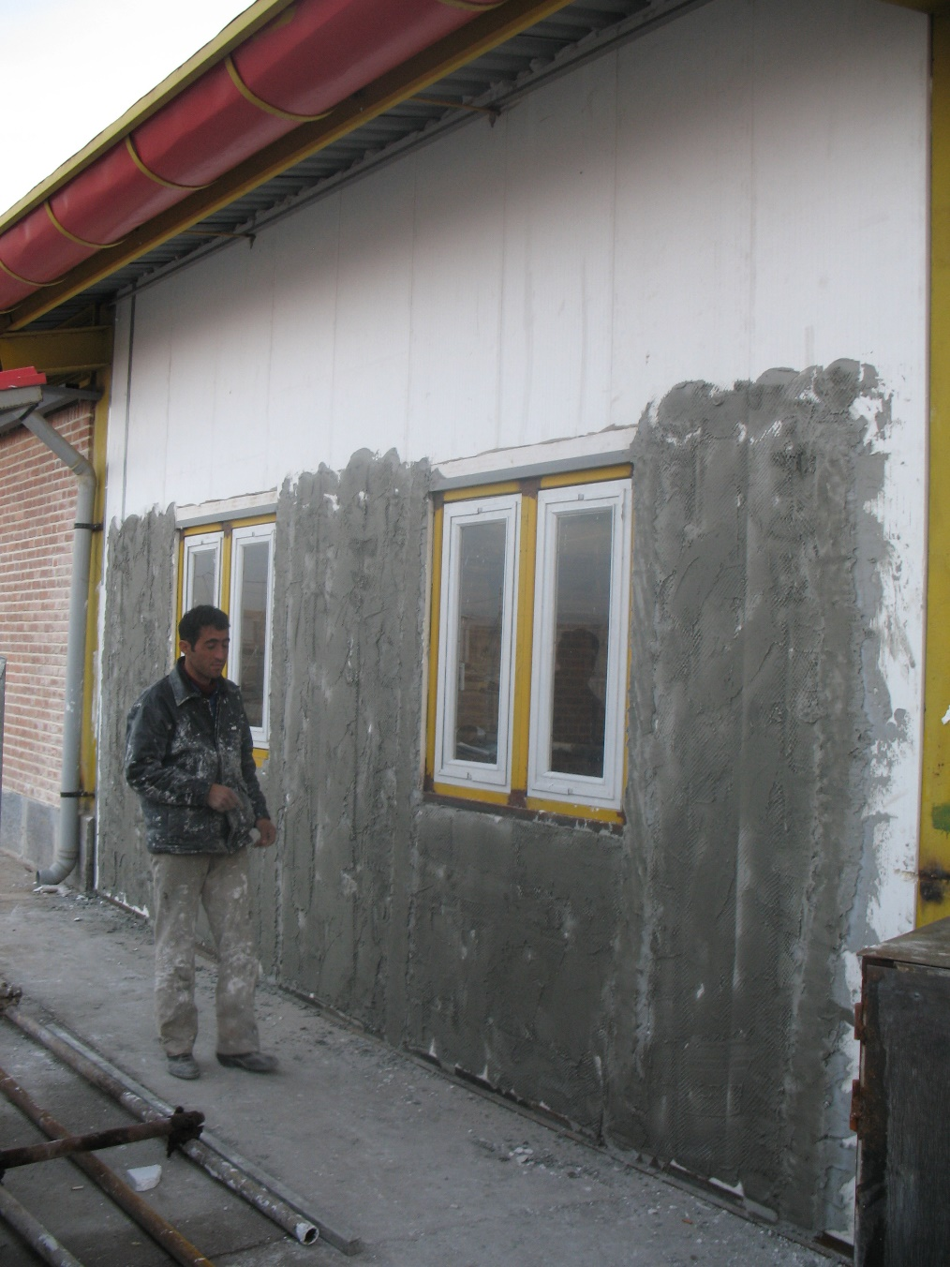
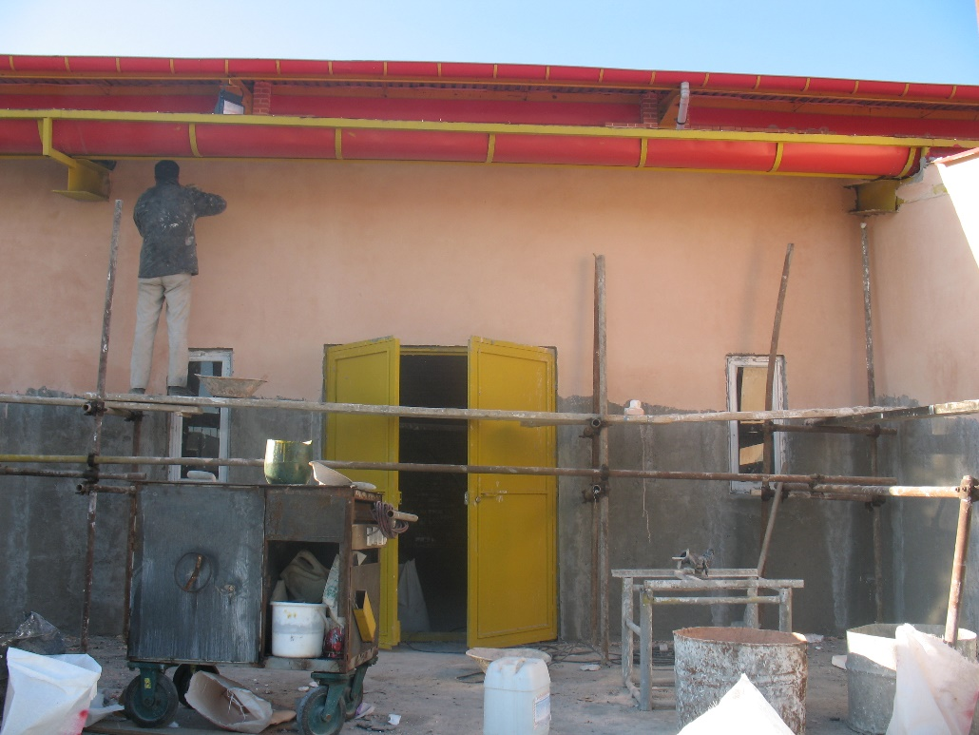
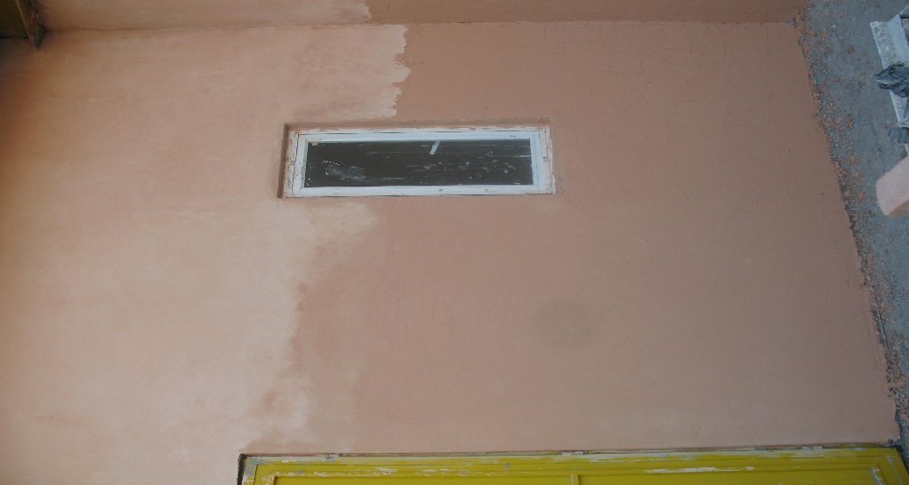
Qazvin 1386

Slide 8
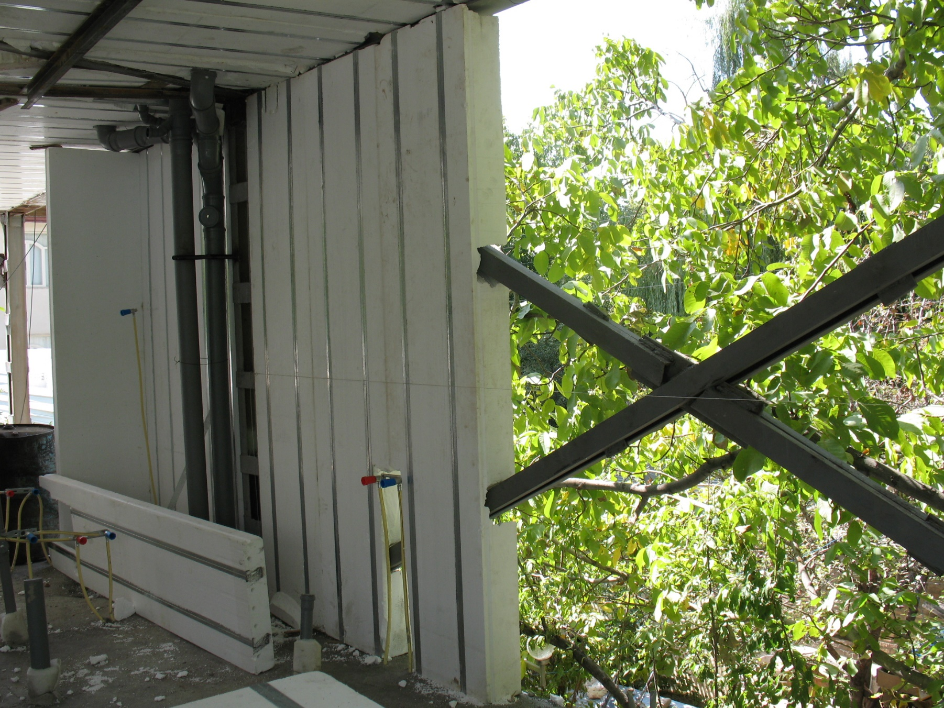
Damavand 1386

Slide 9
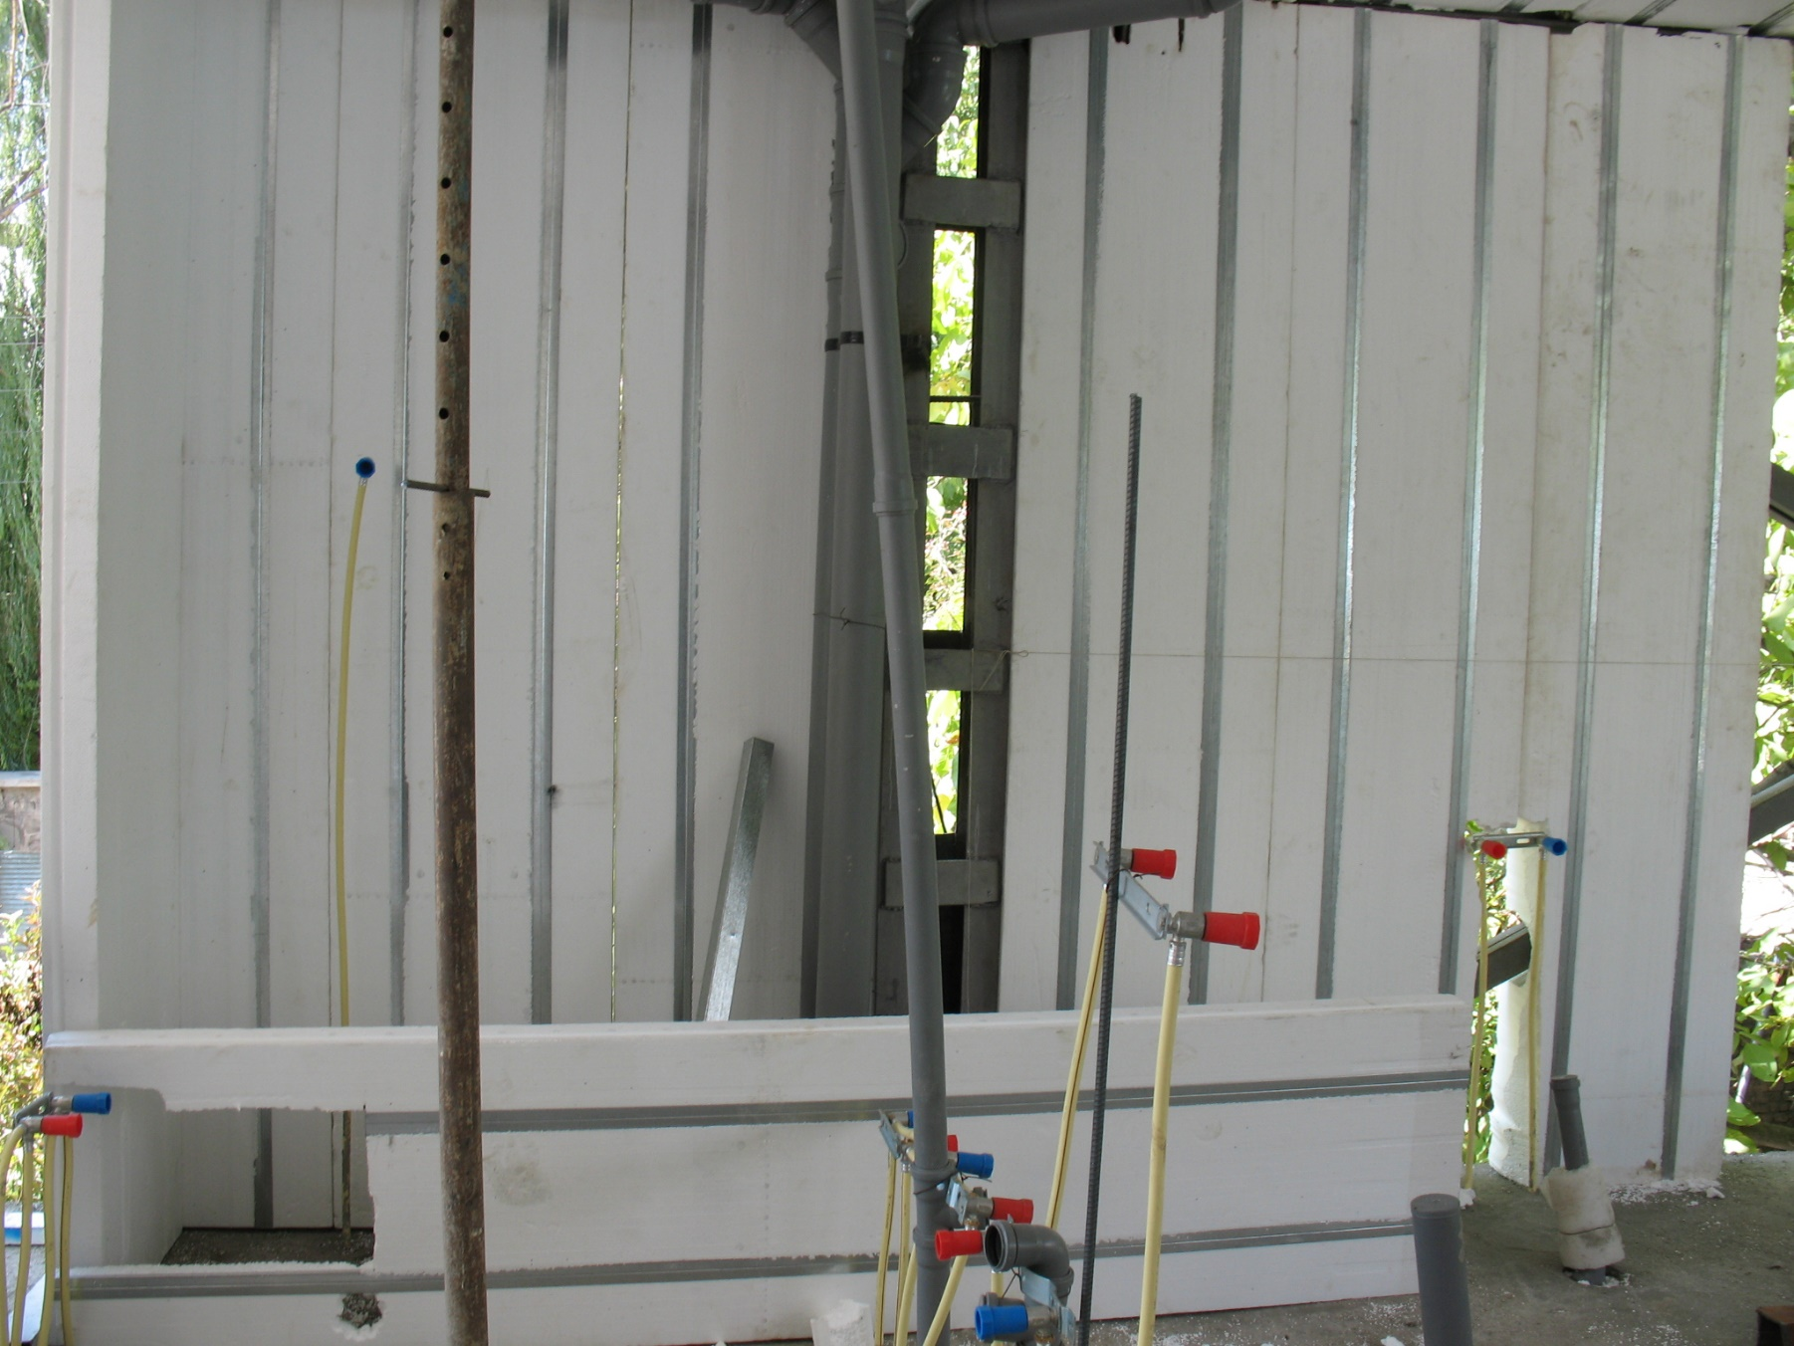
Damavand 1386

Slide 10
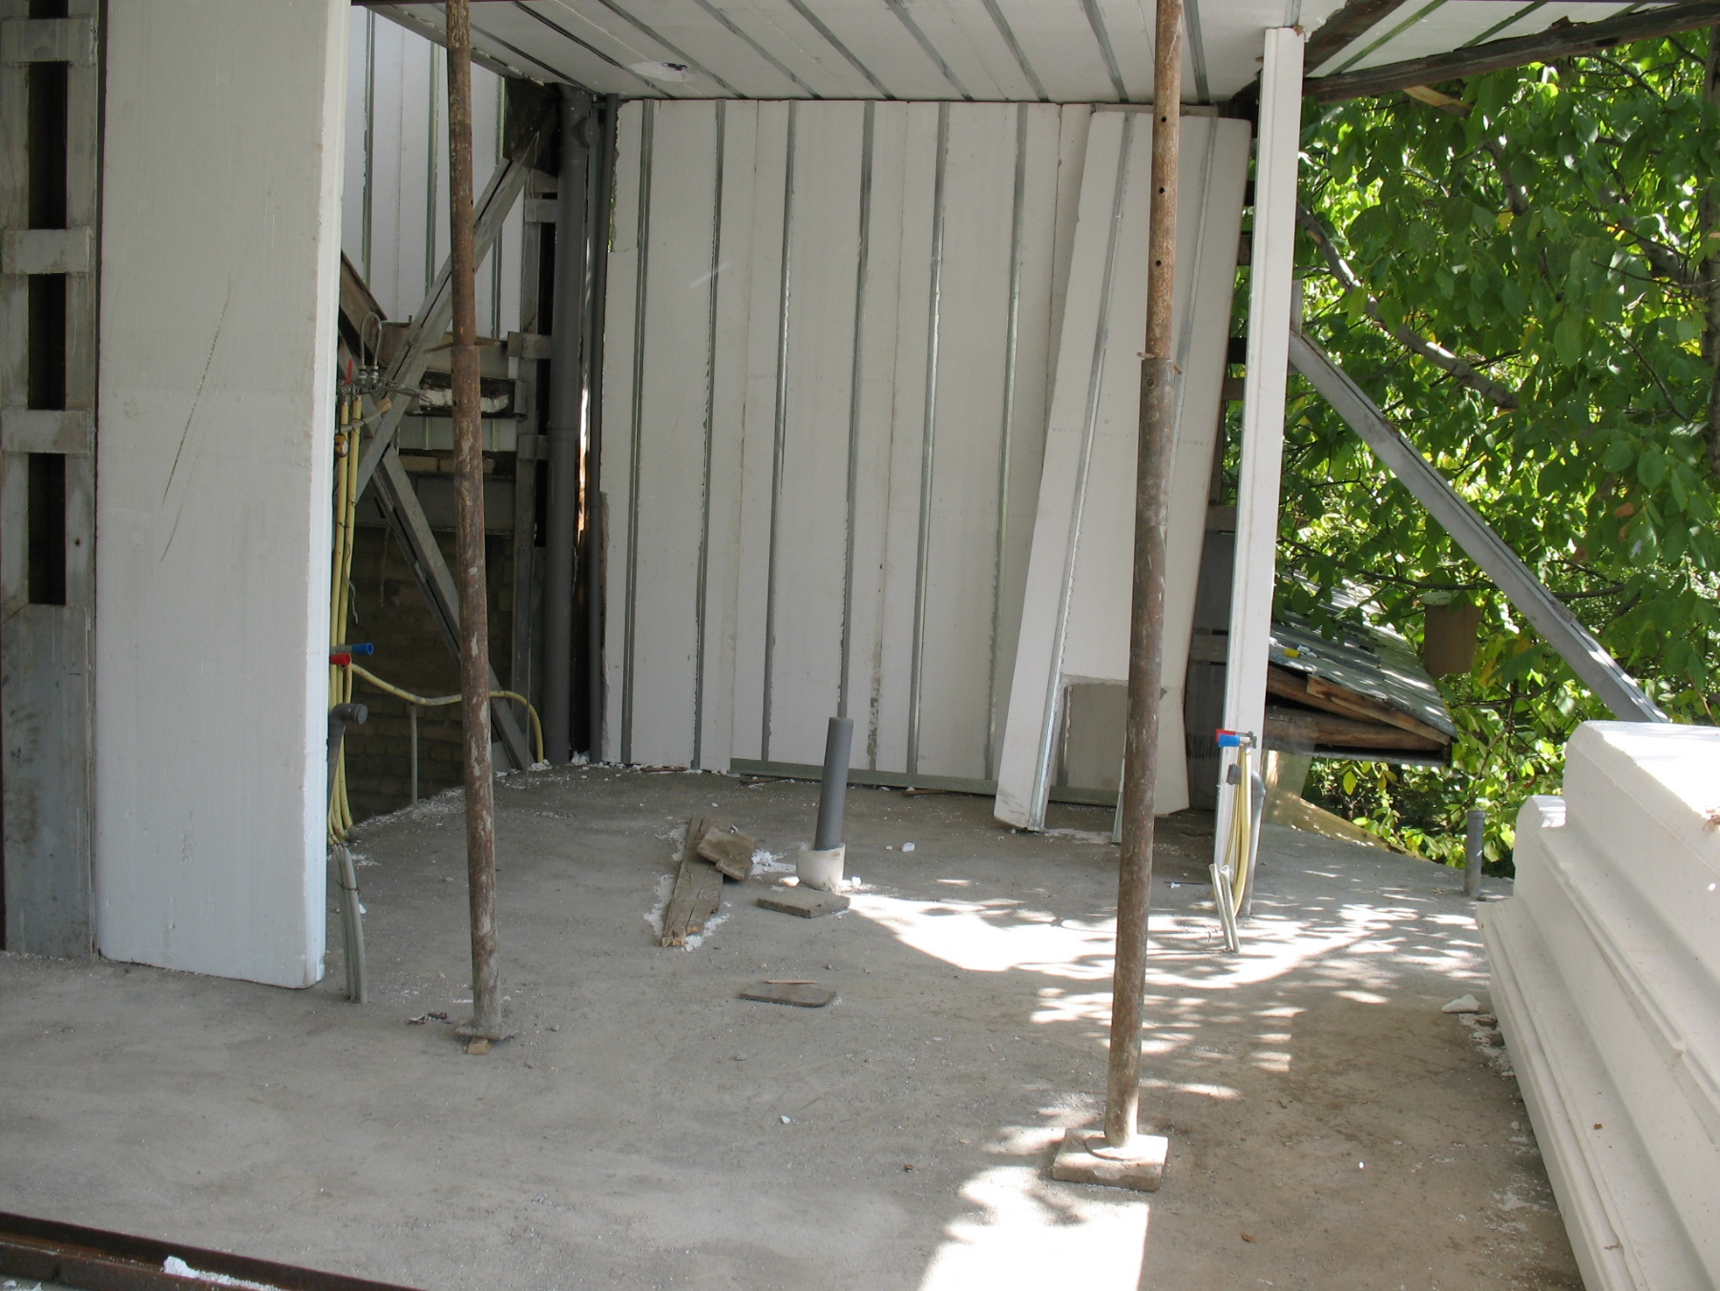
Damavand 1386

Slide 11
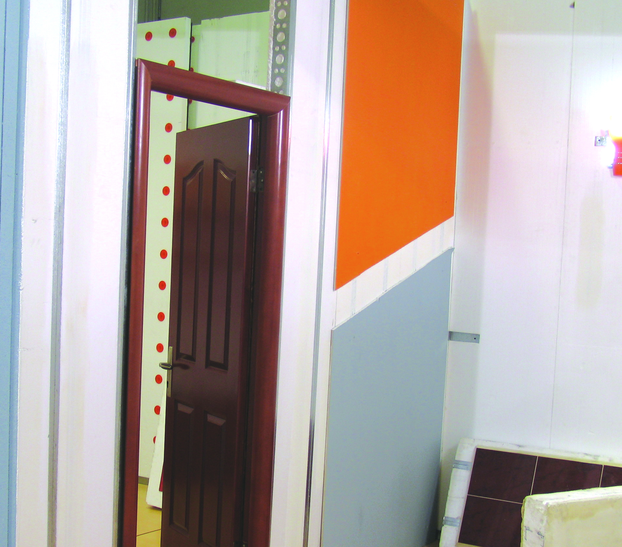
Tehran International fair 1386

Slide 12
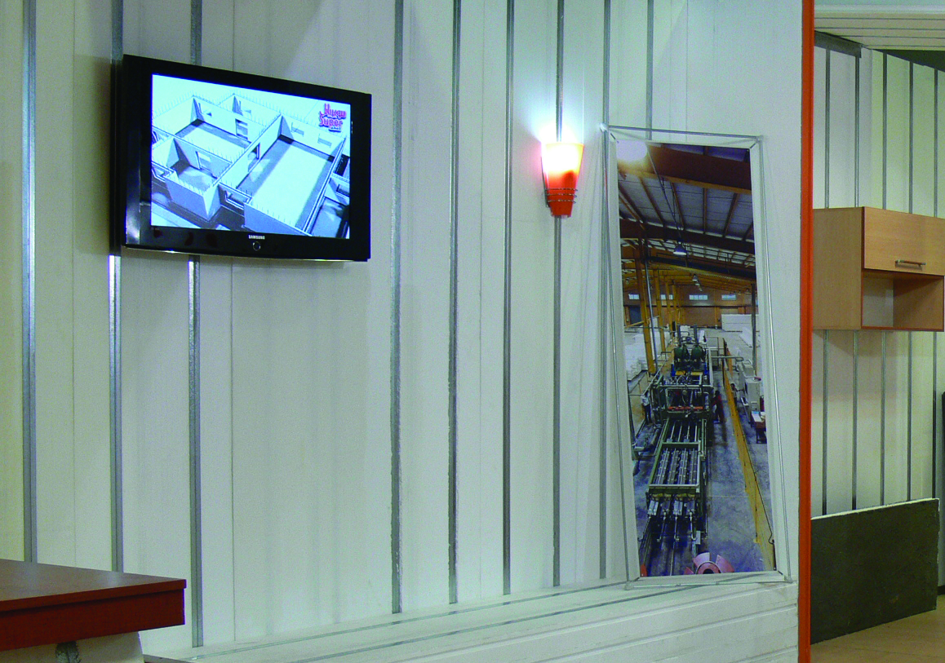
Tehran International fair 1386

Slide 13
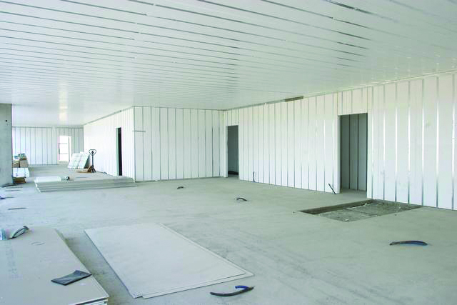
Italy 2004

Slide 14
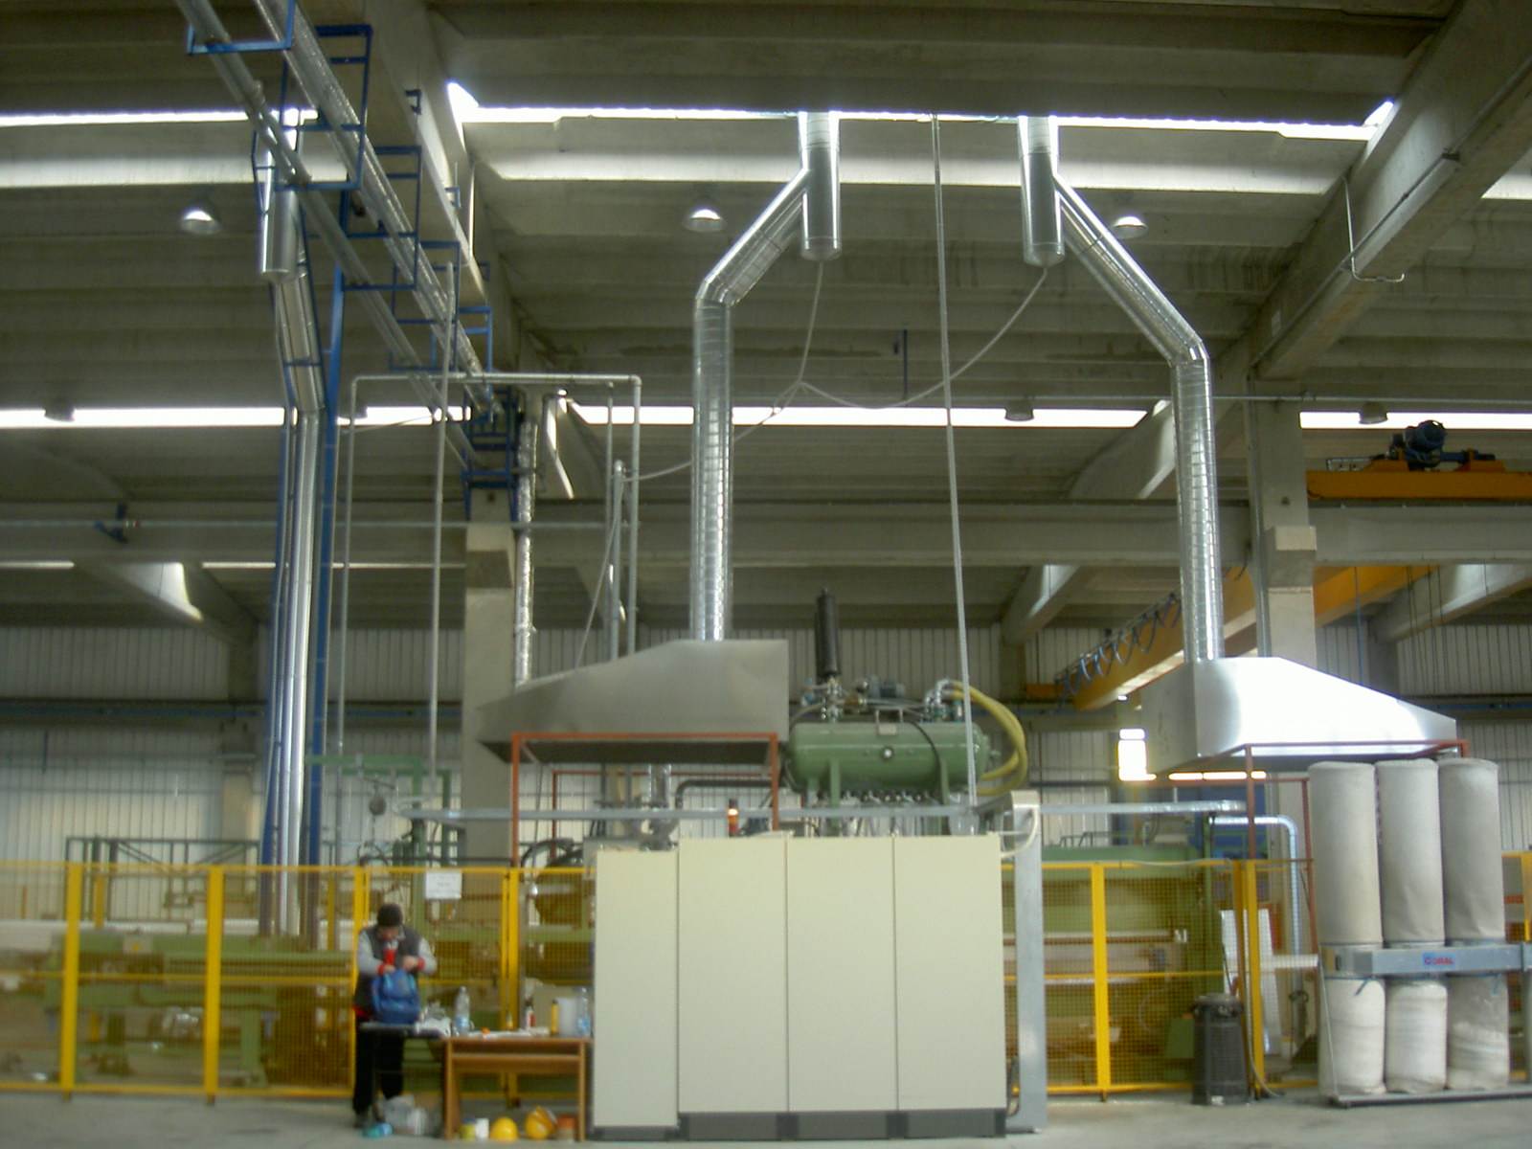
Italy 2004

Slide 15
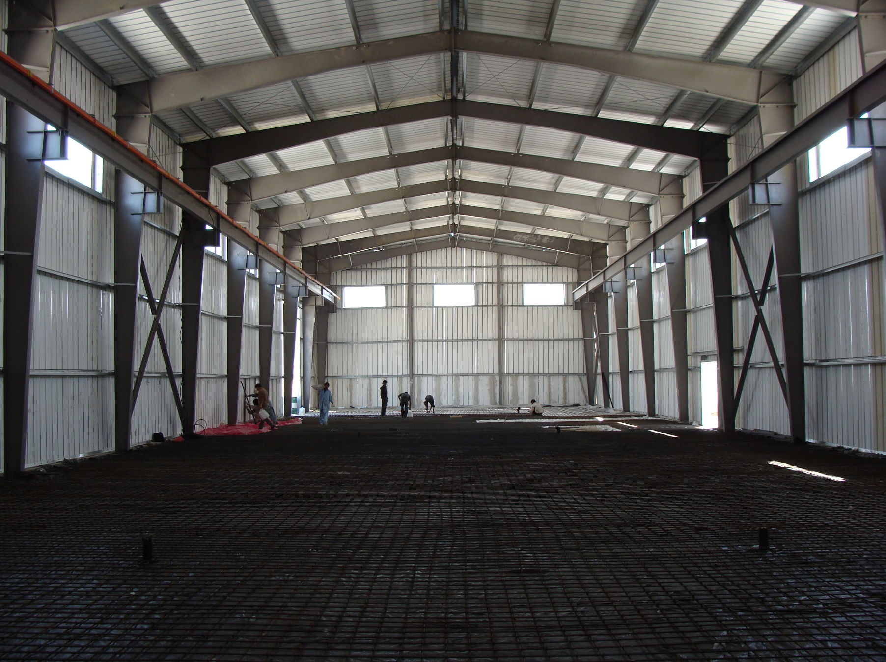
QESHM 1386

Slide 16
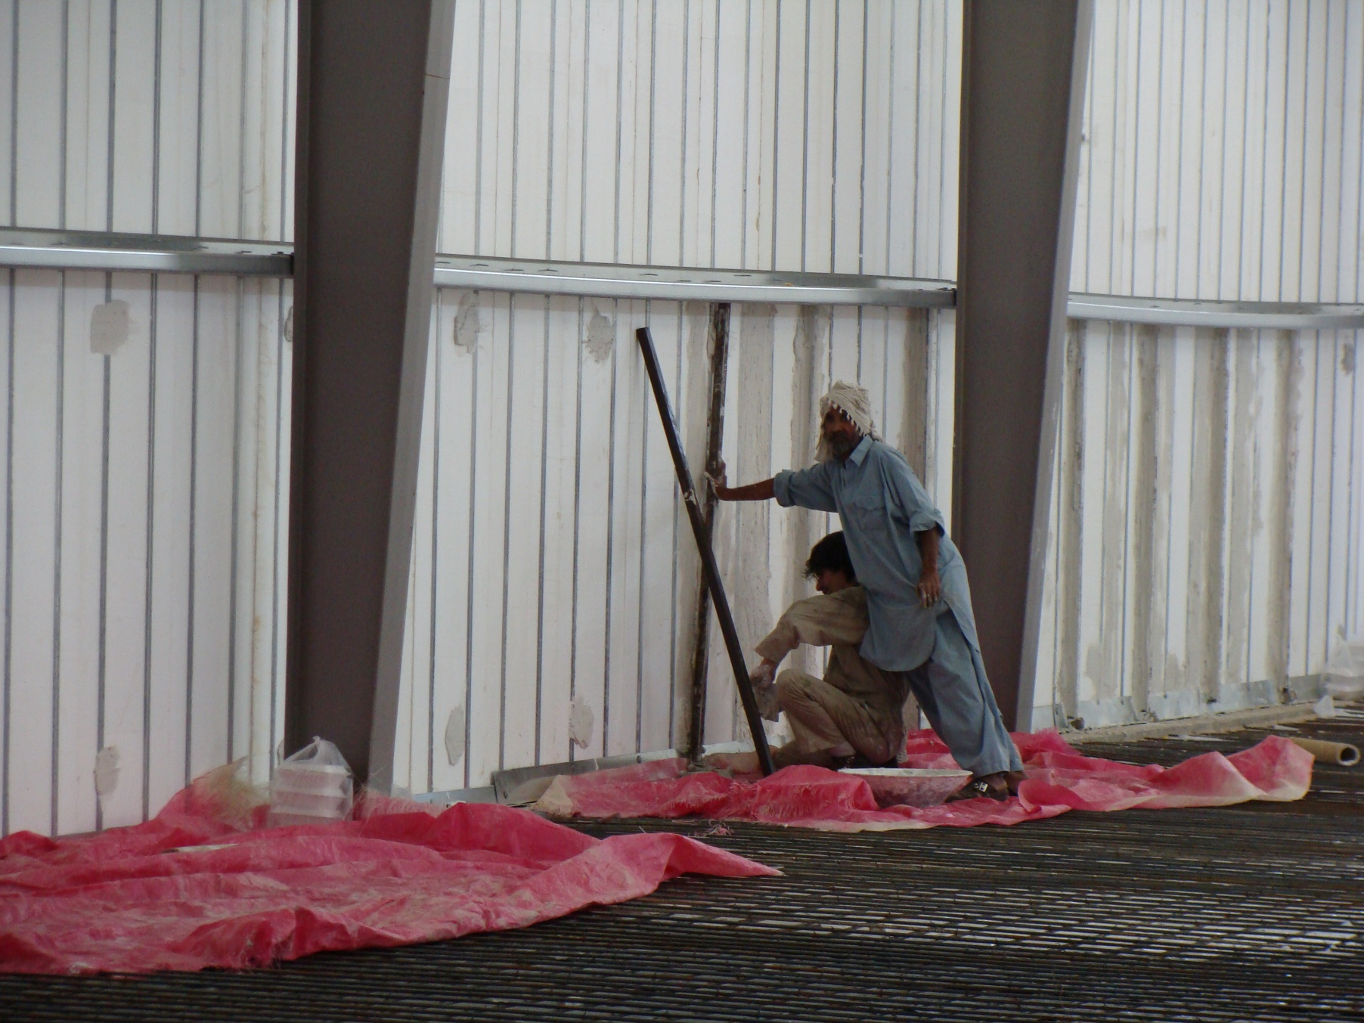
QESHM 1386

Slide 17
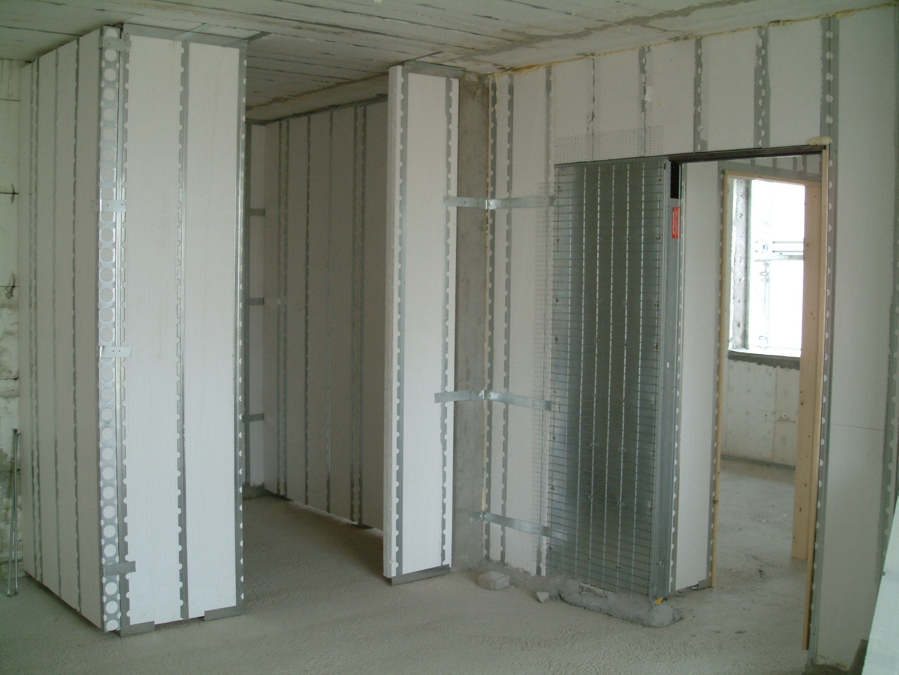
Turkey 2005

Slide 18
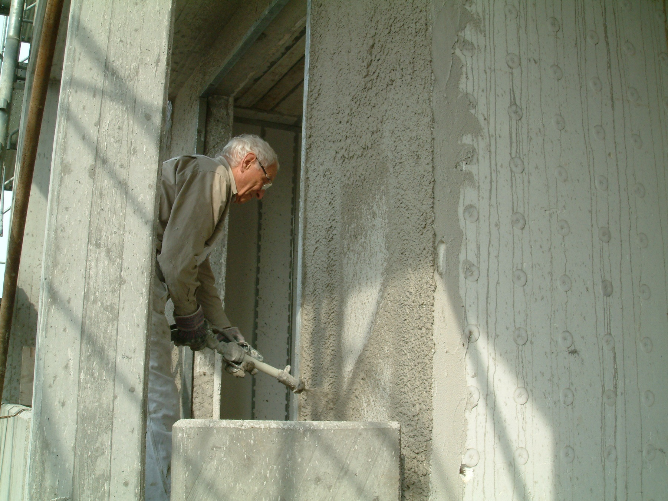
Turkey 2005

Slide 19
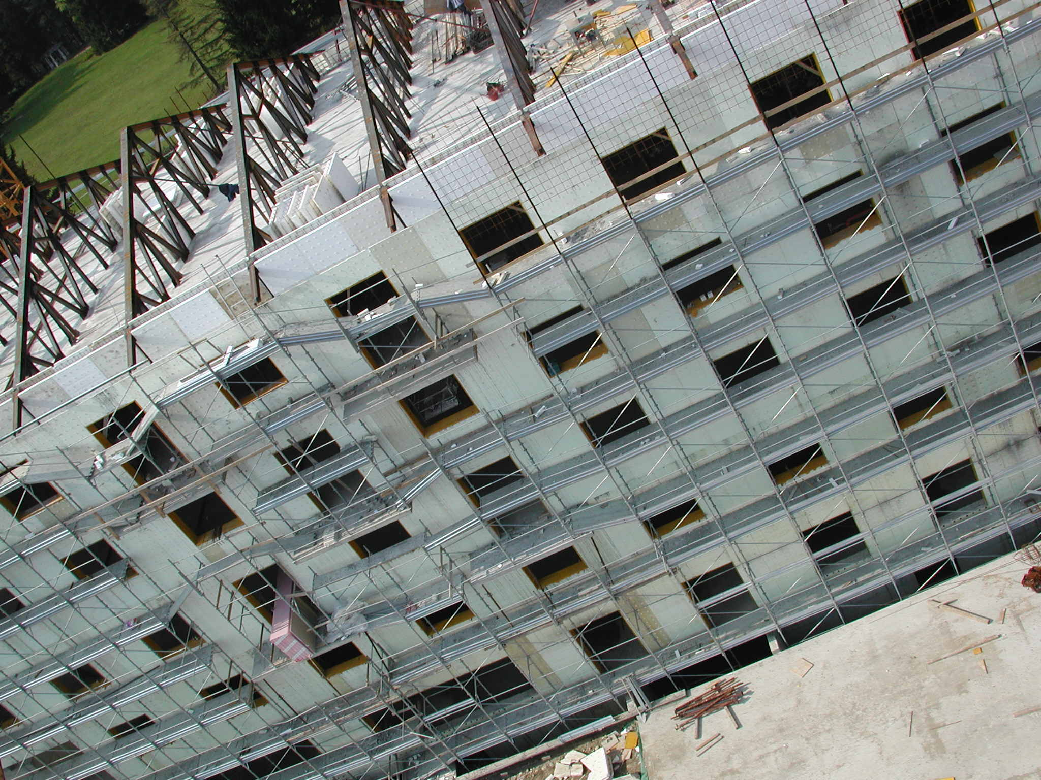
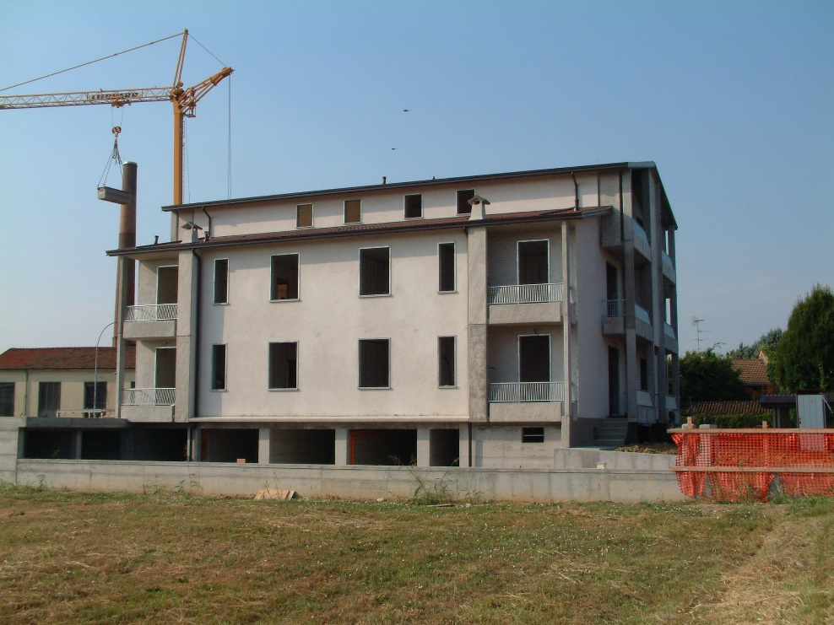
The fast, flexible and safe method to build a concrete floor or roof and wall that saves labor, time and money
WWW.SUPERPANELCO.COM

