Slide 1
PLASTBAU®
Advance Building Products company
شرکت فرآورده های پیشرفته ساختمانی
دیوار مسلح
Reinforced Wall

Slide 2
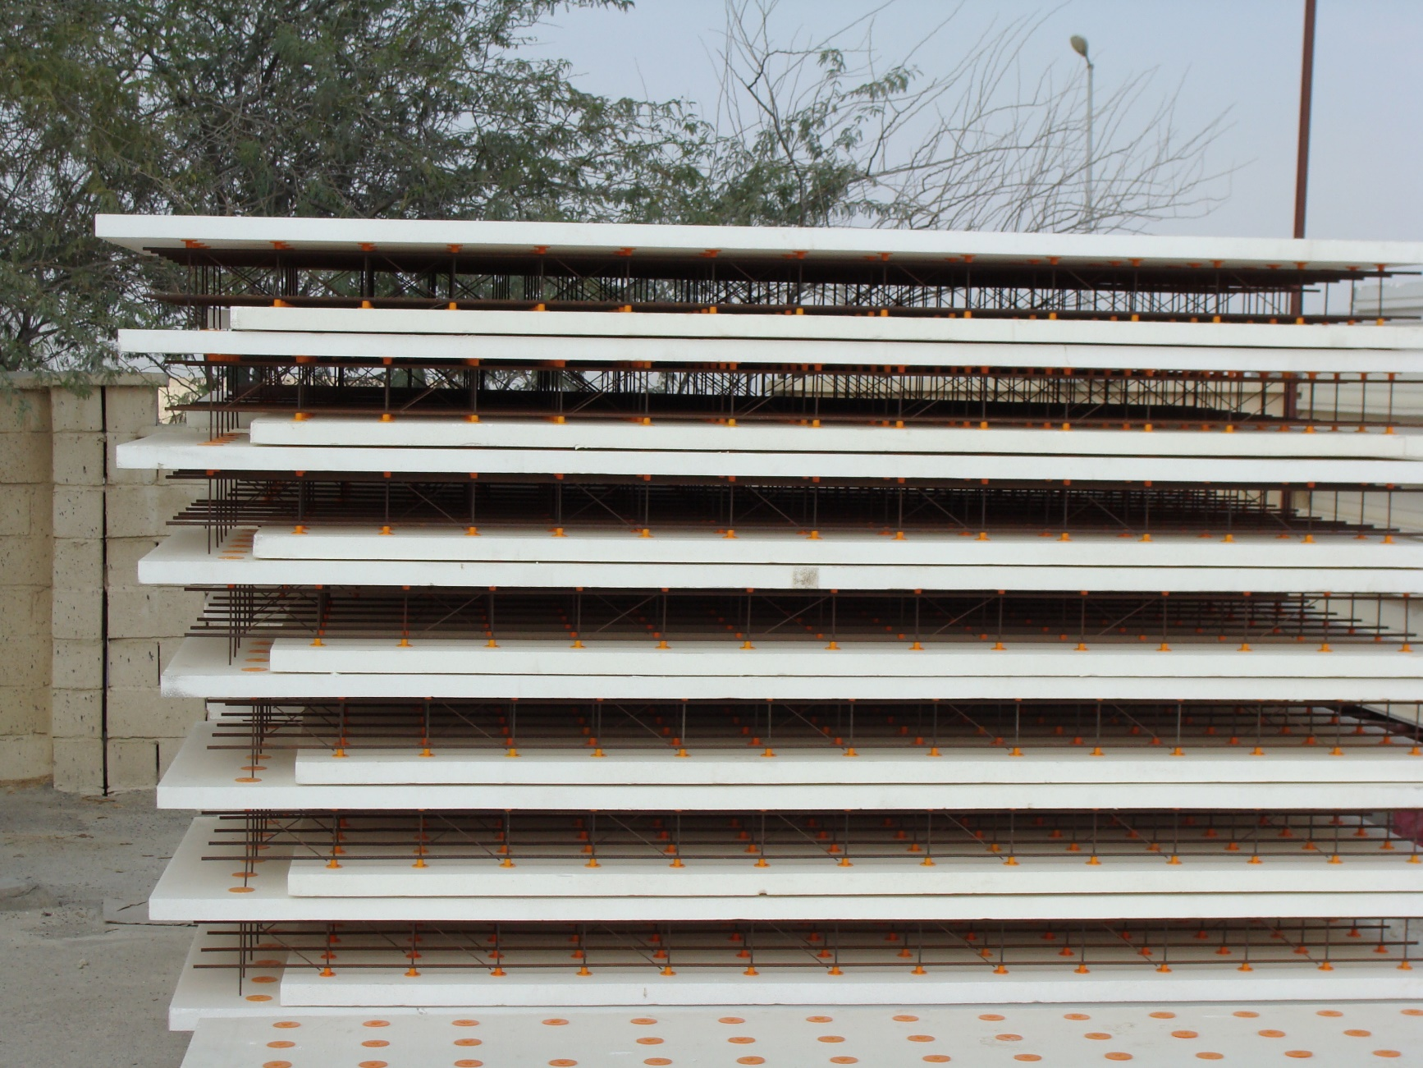
حمل و نقل و دپوی آسان
EASY TRANSPORTATION AND EASY STACKING

Slide 3
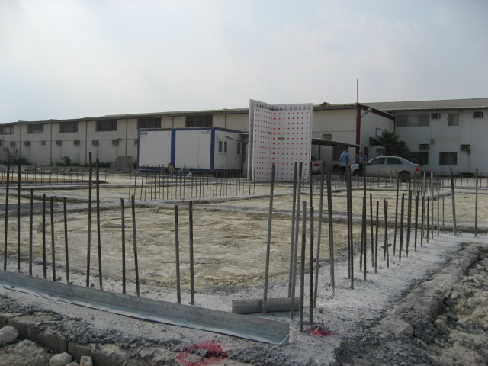
نصب سریع و آسان
EASY INSTALLATION
Qeshm 1386

Slide 4
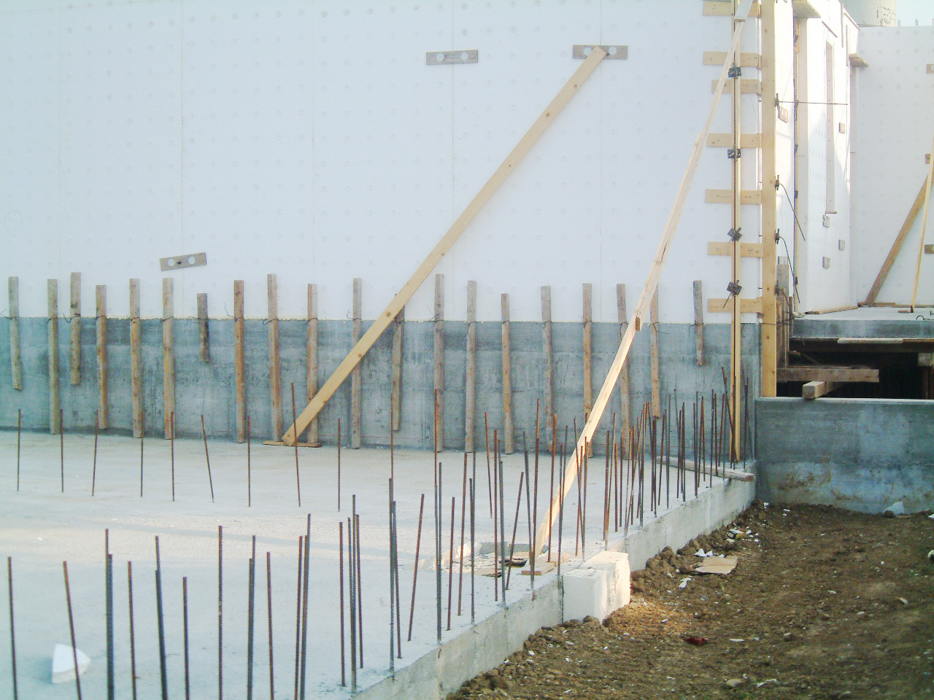
Italy 2005

Slide 5
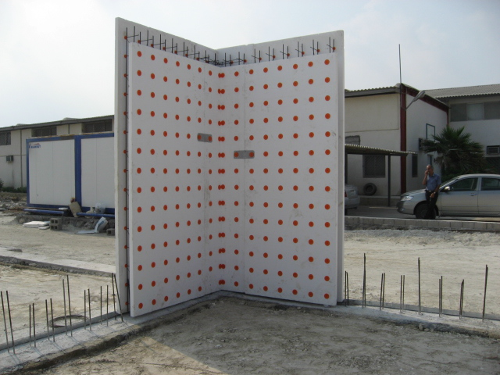
Qeshm 1386

Slide 6
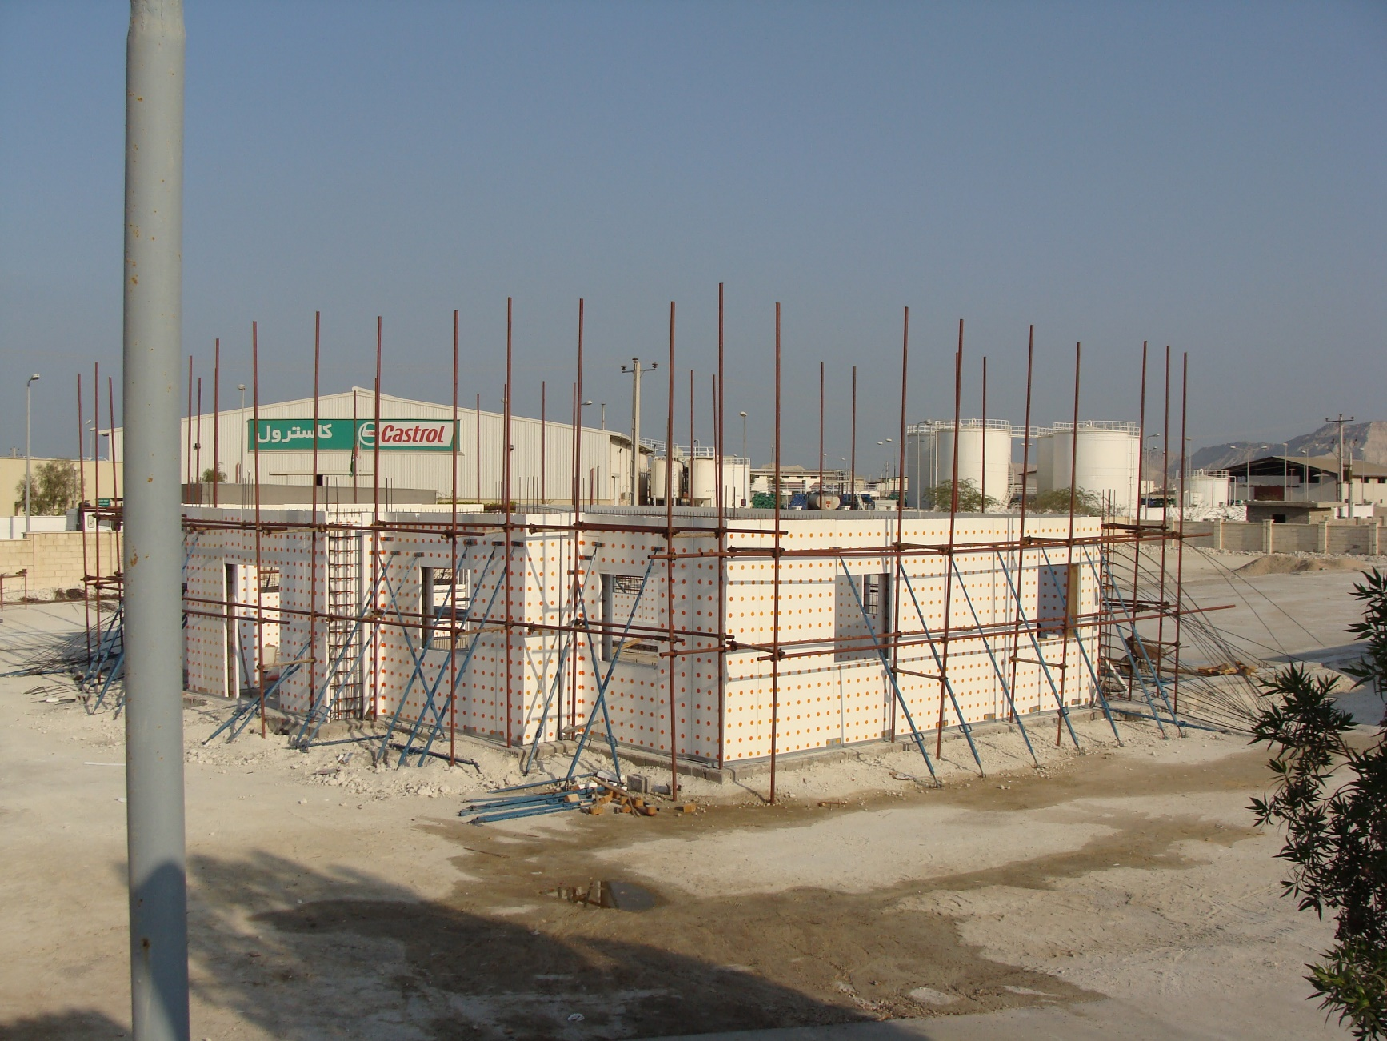
Qeshm 1386

Slide 7
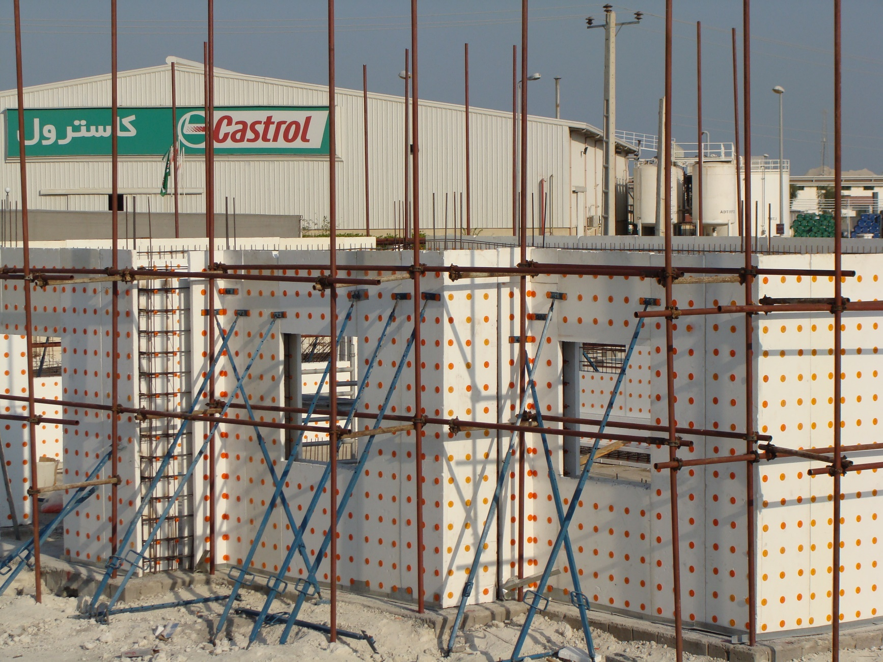
Qeshm 1386

Slide 8
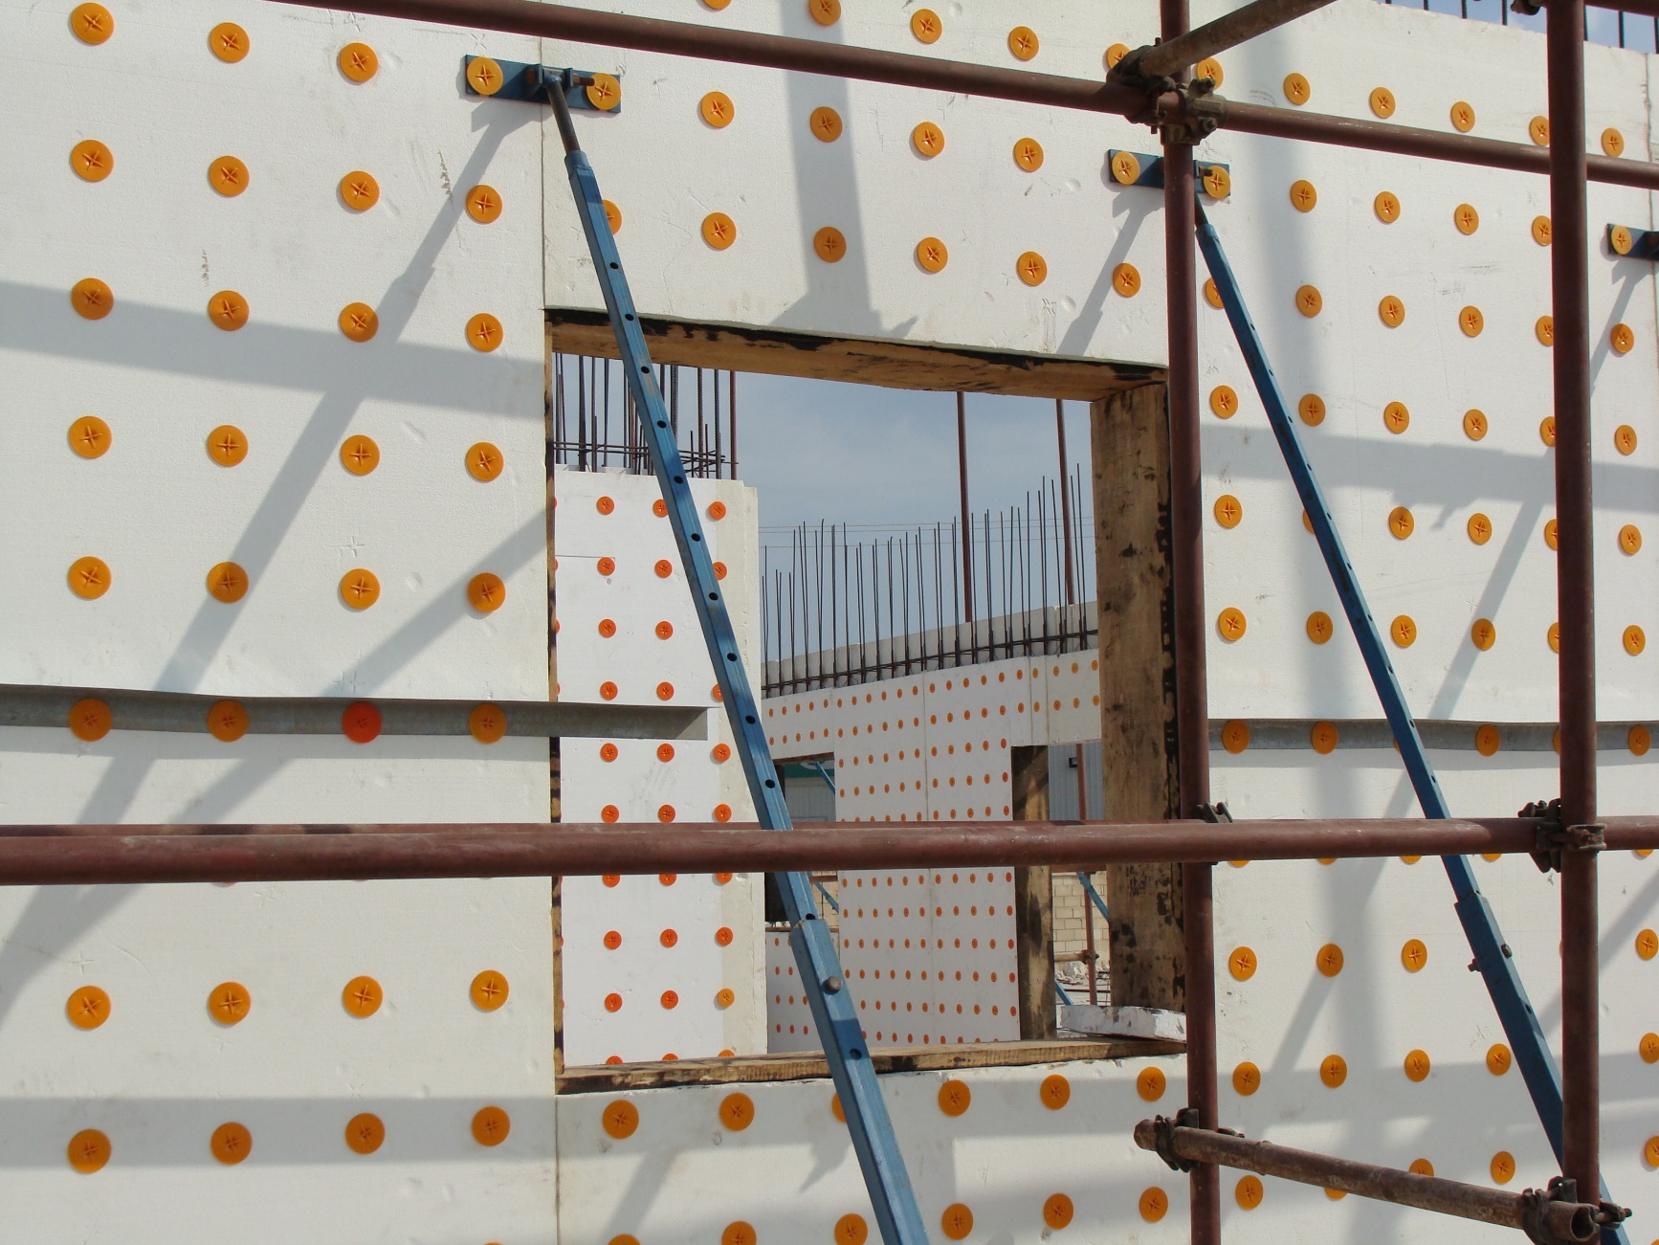
Qeshm 1386

Slide 9
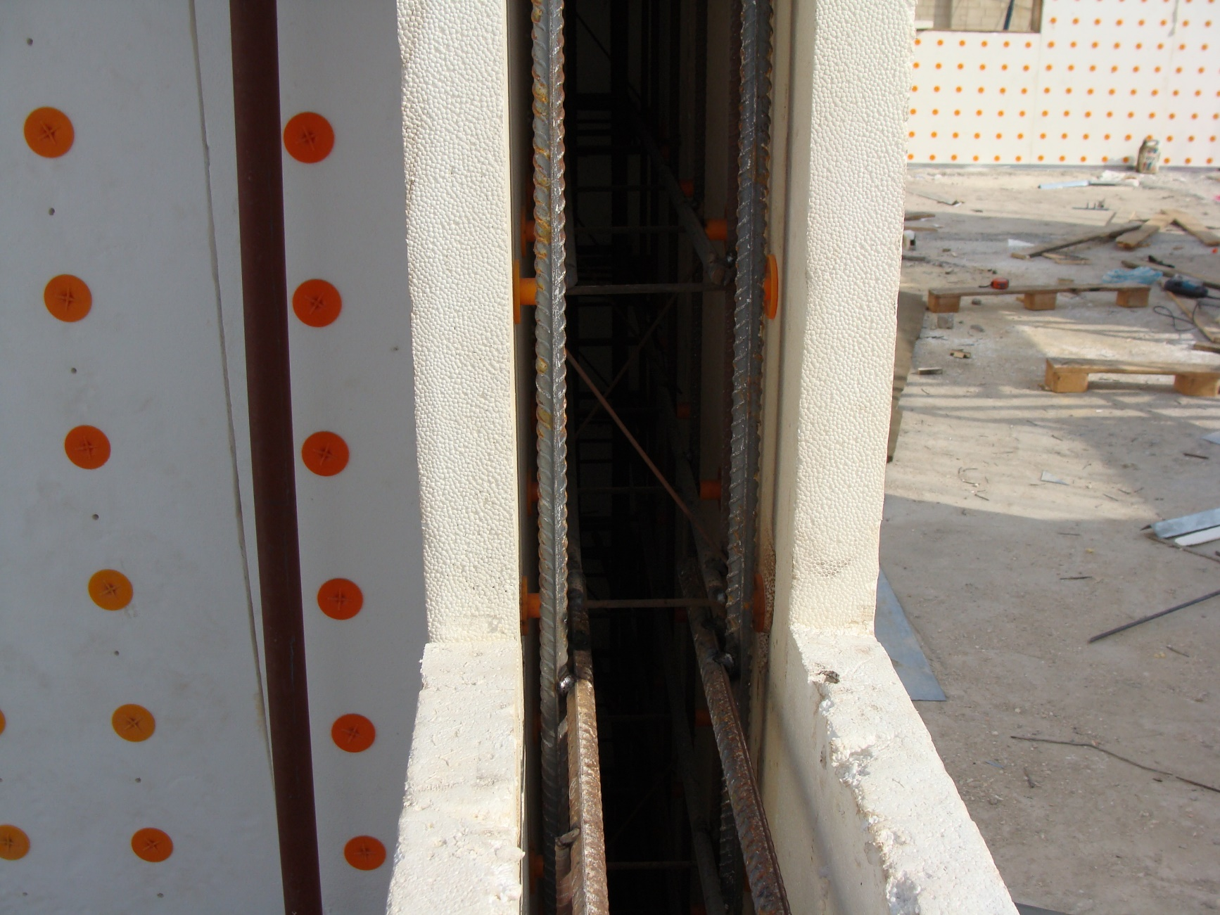
Qeshm 1386

Slide 10
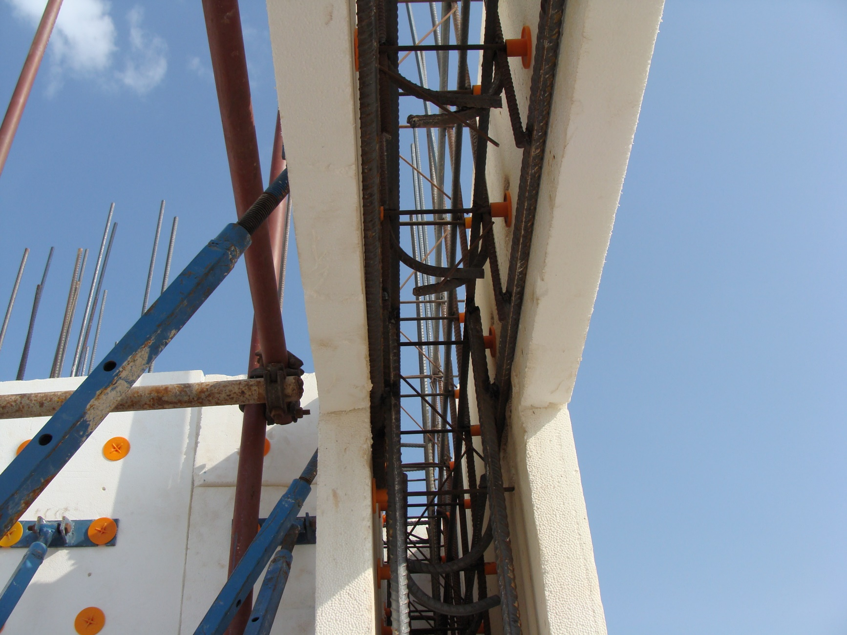
Qeshm 1386

Slide 11
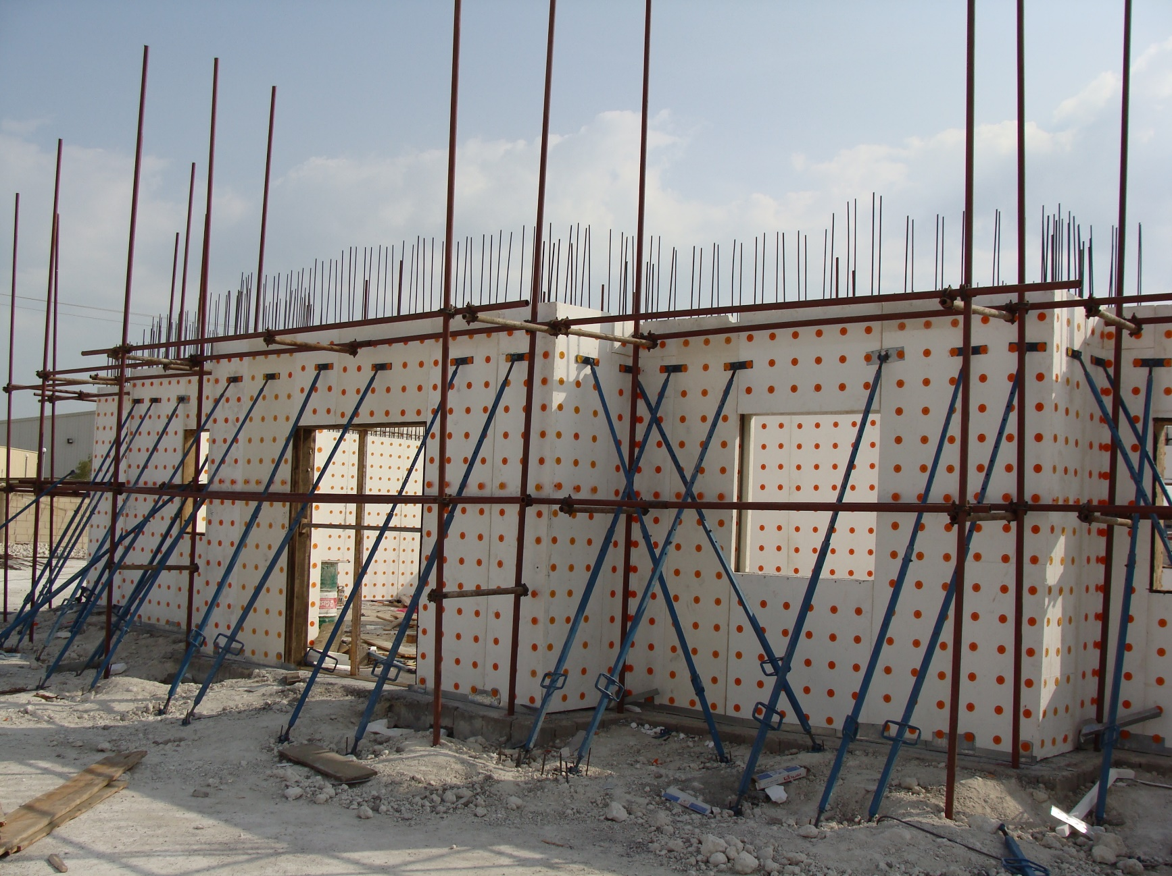
Qeshm 1386

Slide 12
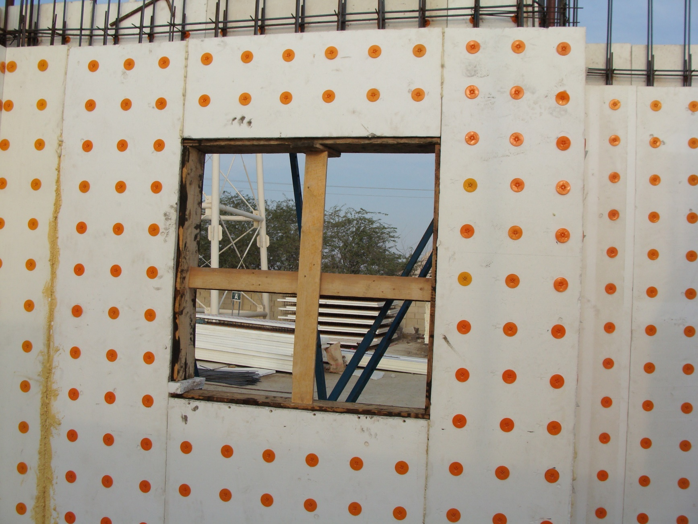
Qeshm 1386

Slide 13
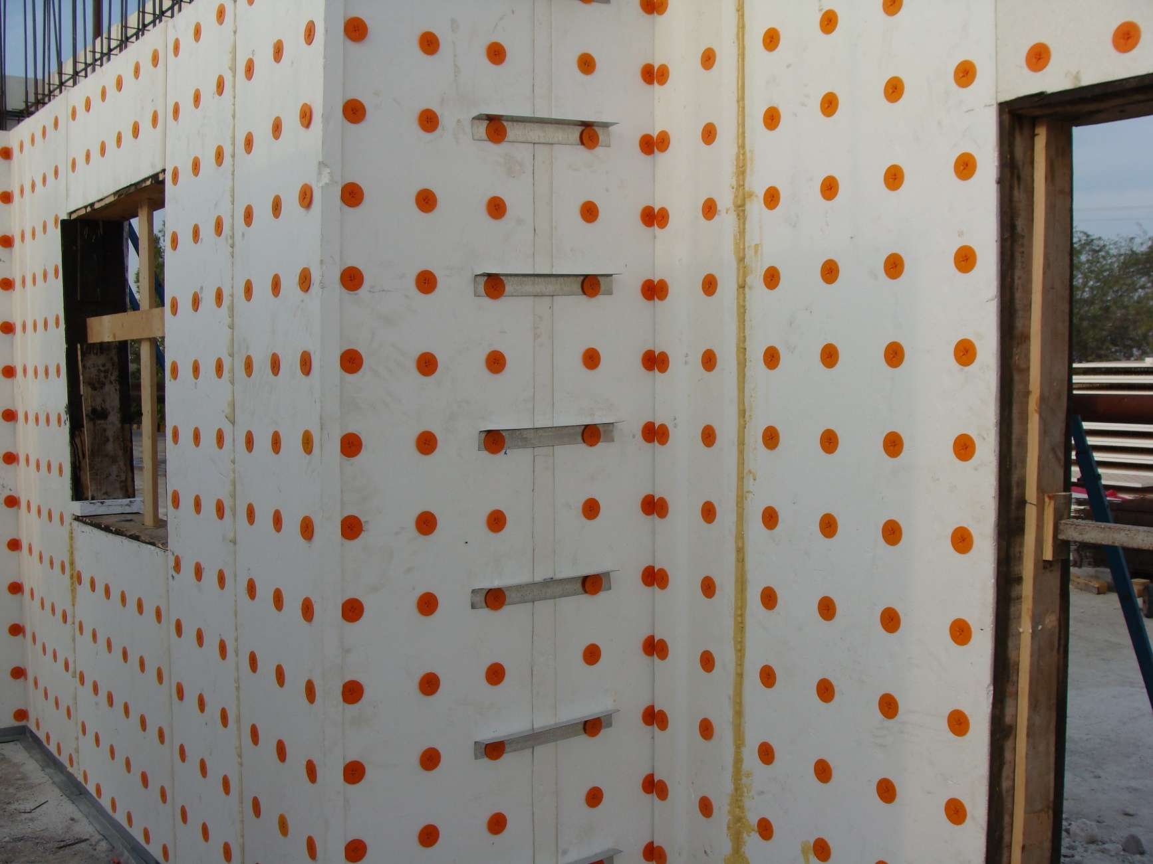
Qeshm 1386

Slide 14
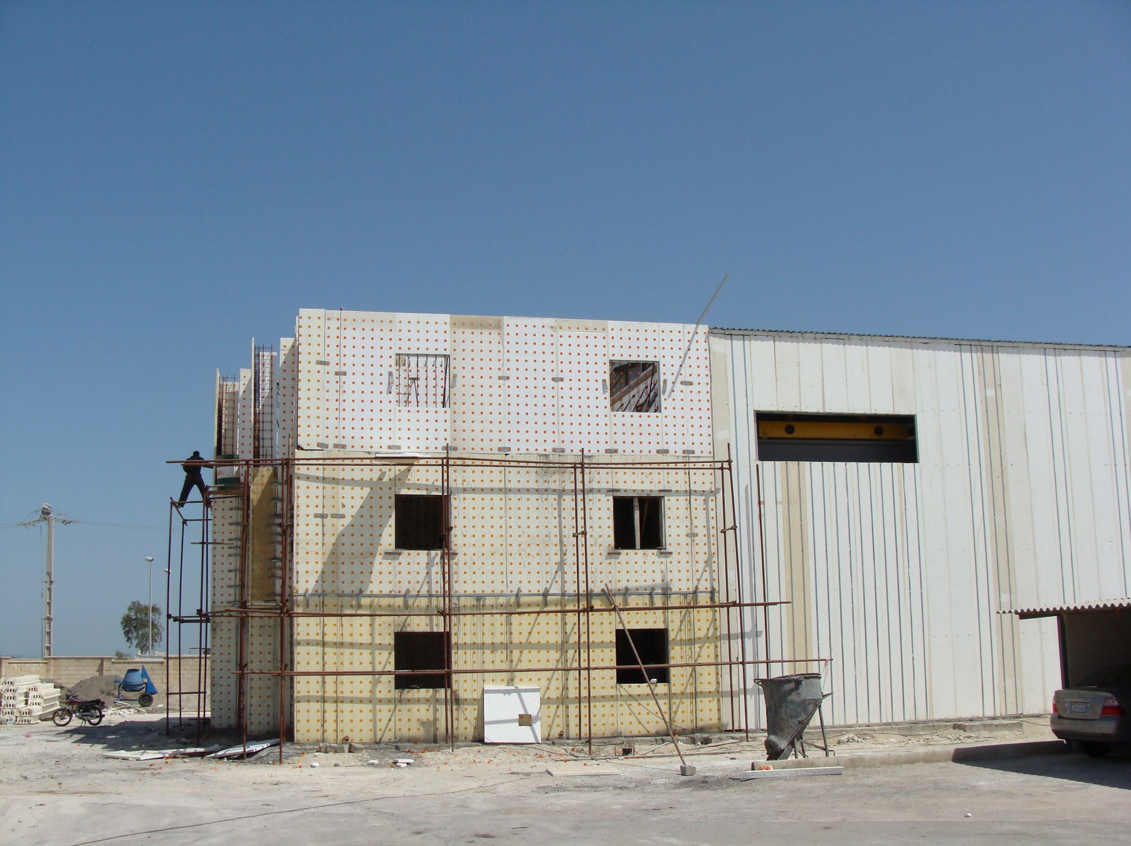
Qeshm 1386

Slide 15
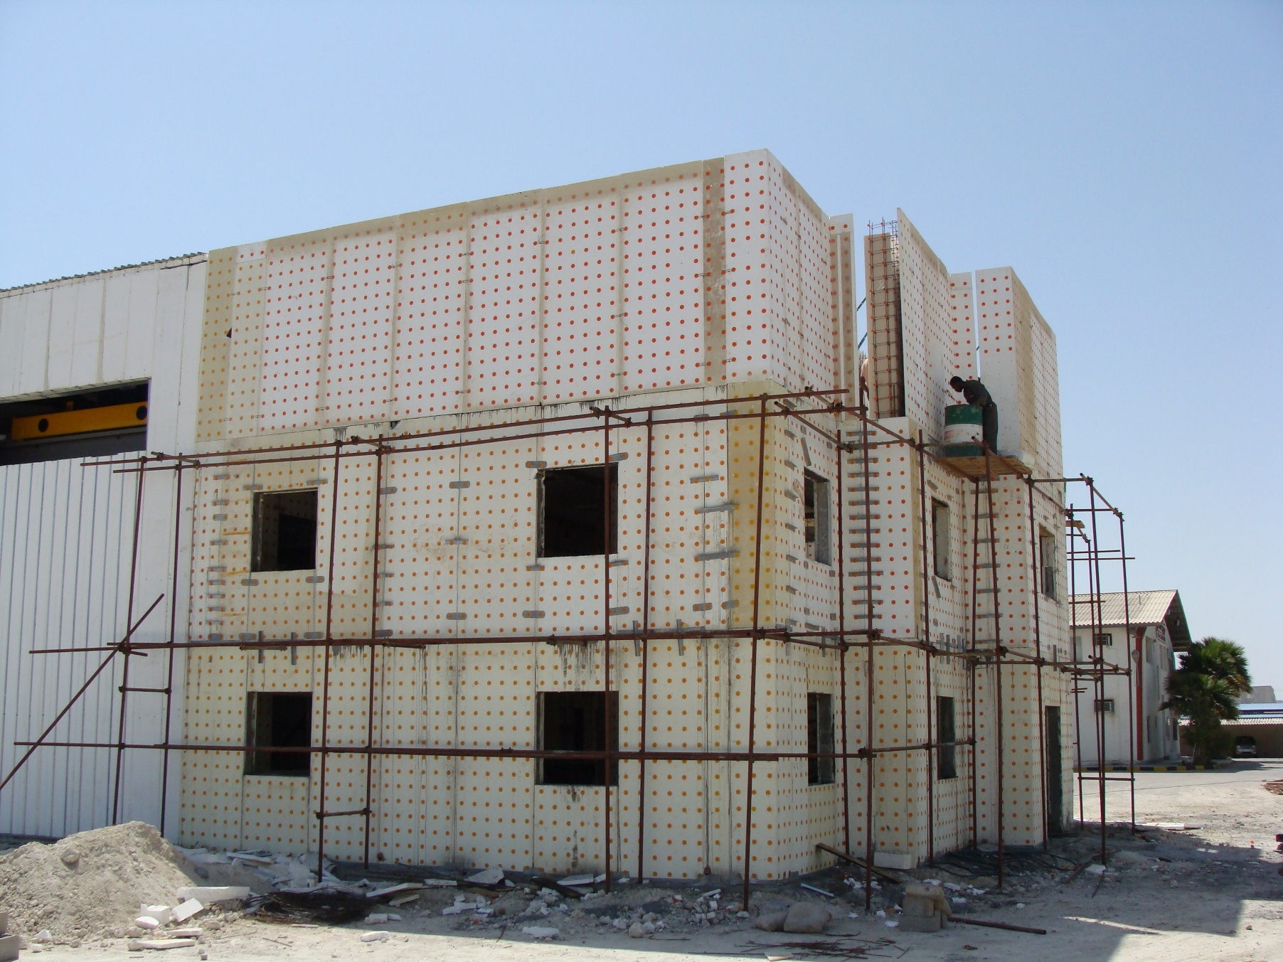
Qeshm 1386

Slide 16
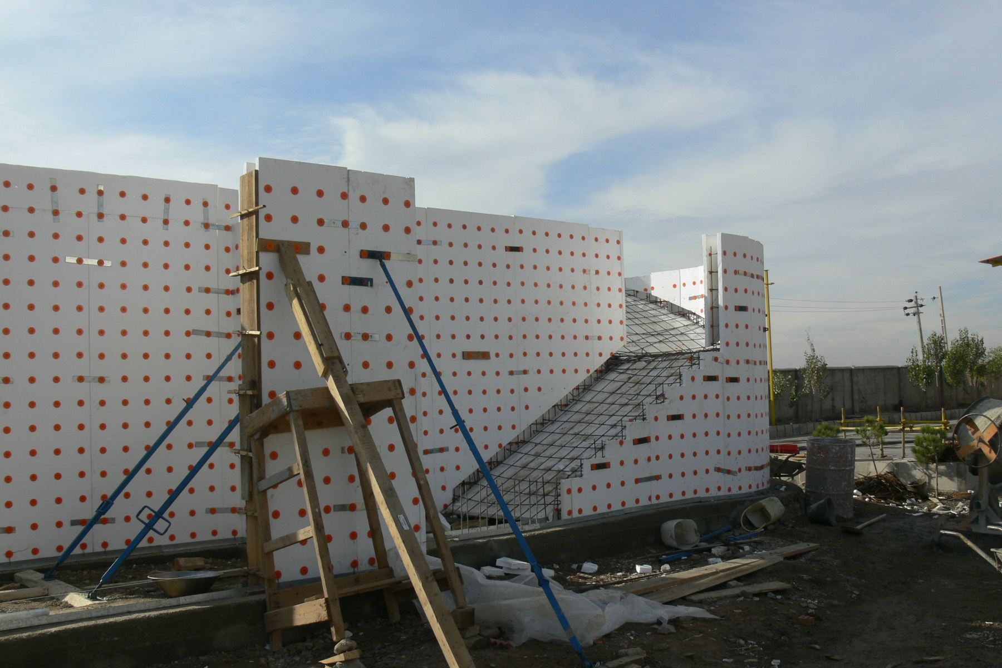
Qazvin 1386

Slide 17
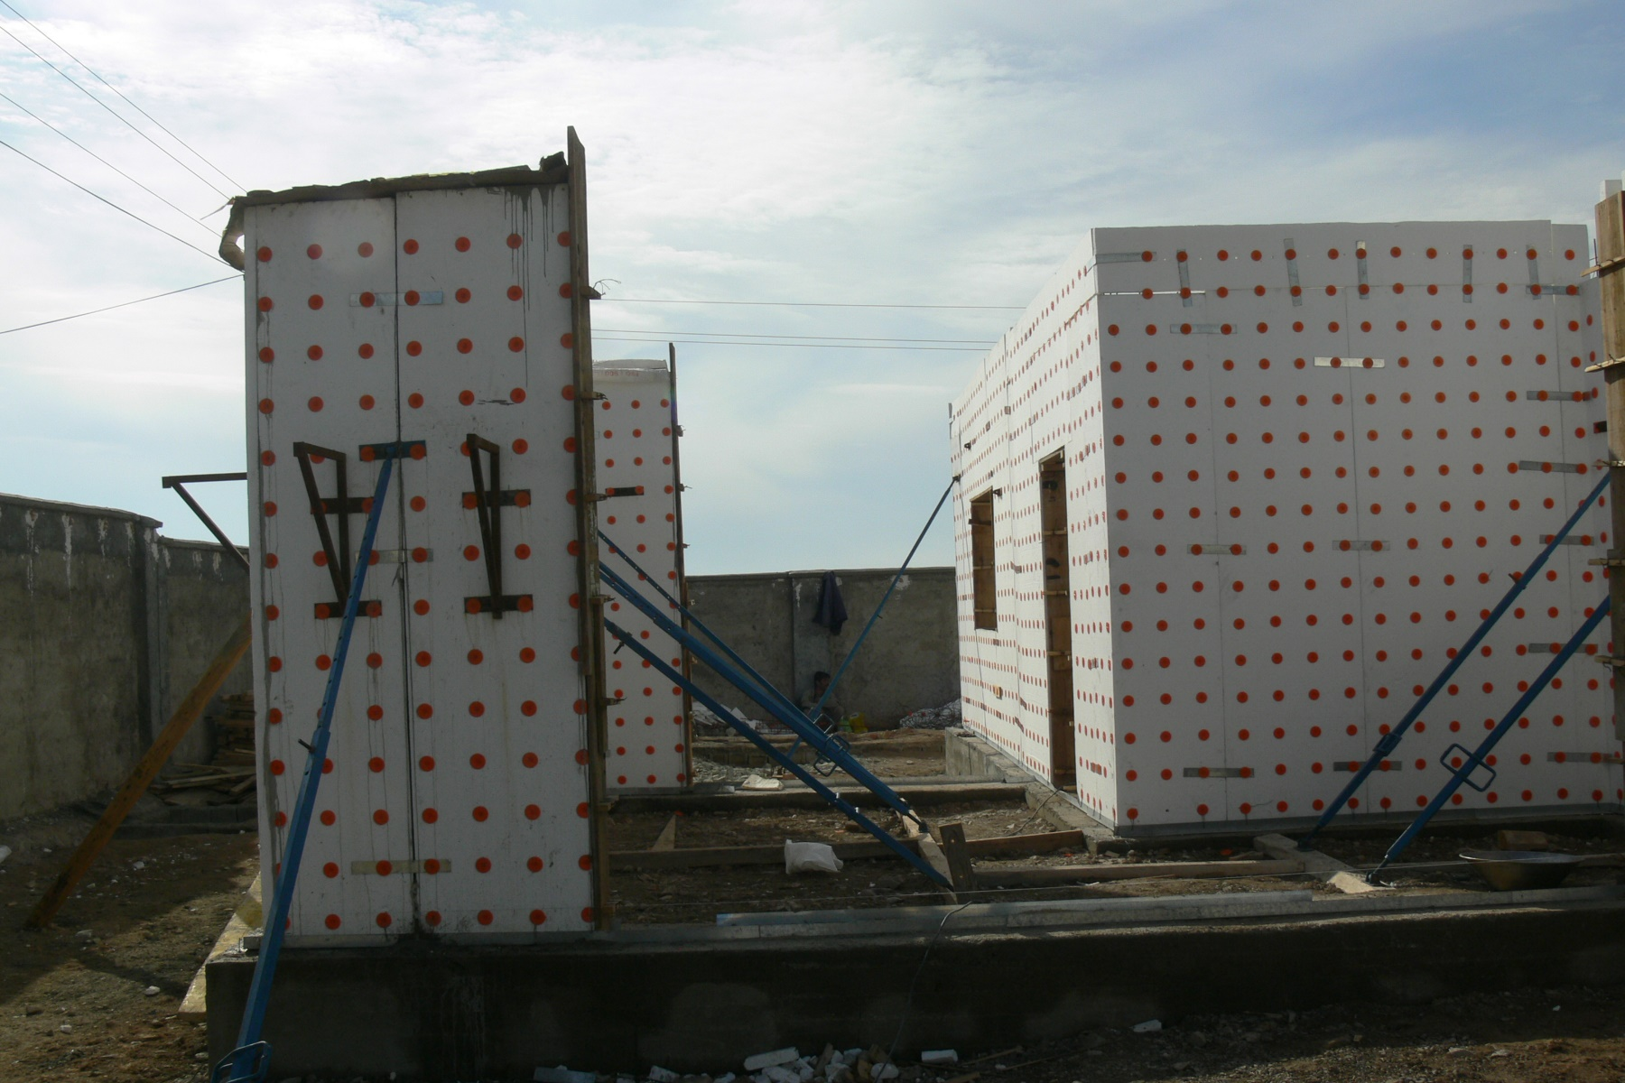
Qazvin 1386

Slide 18
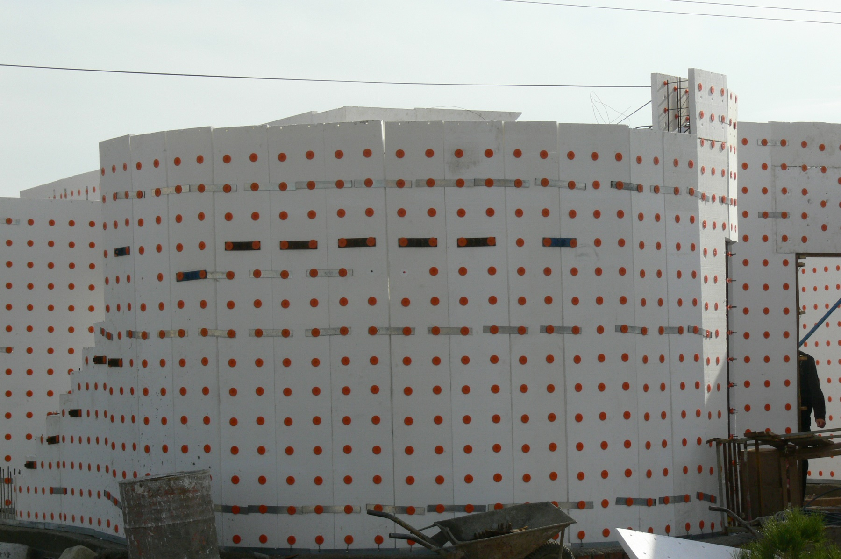
Qazvin 1386

Slide 19
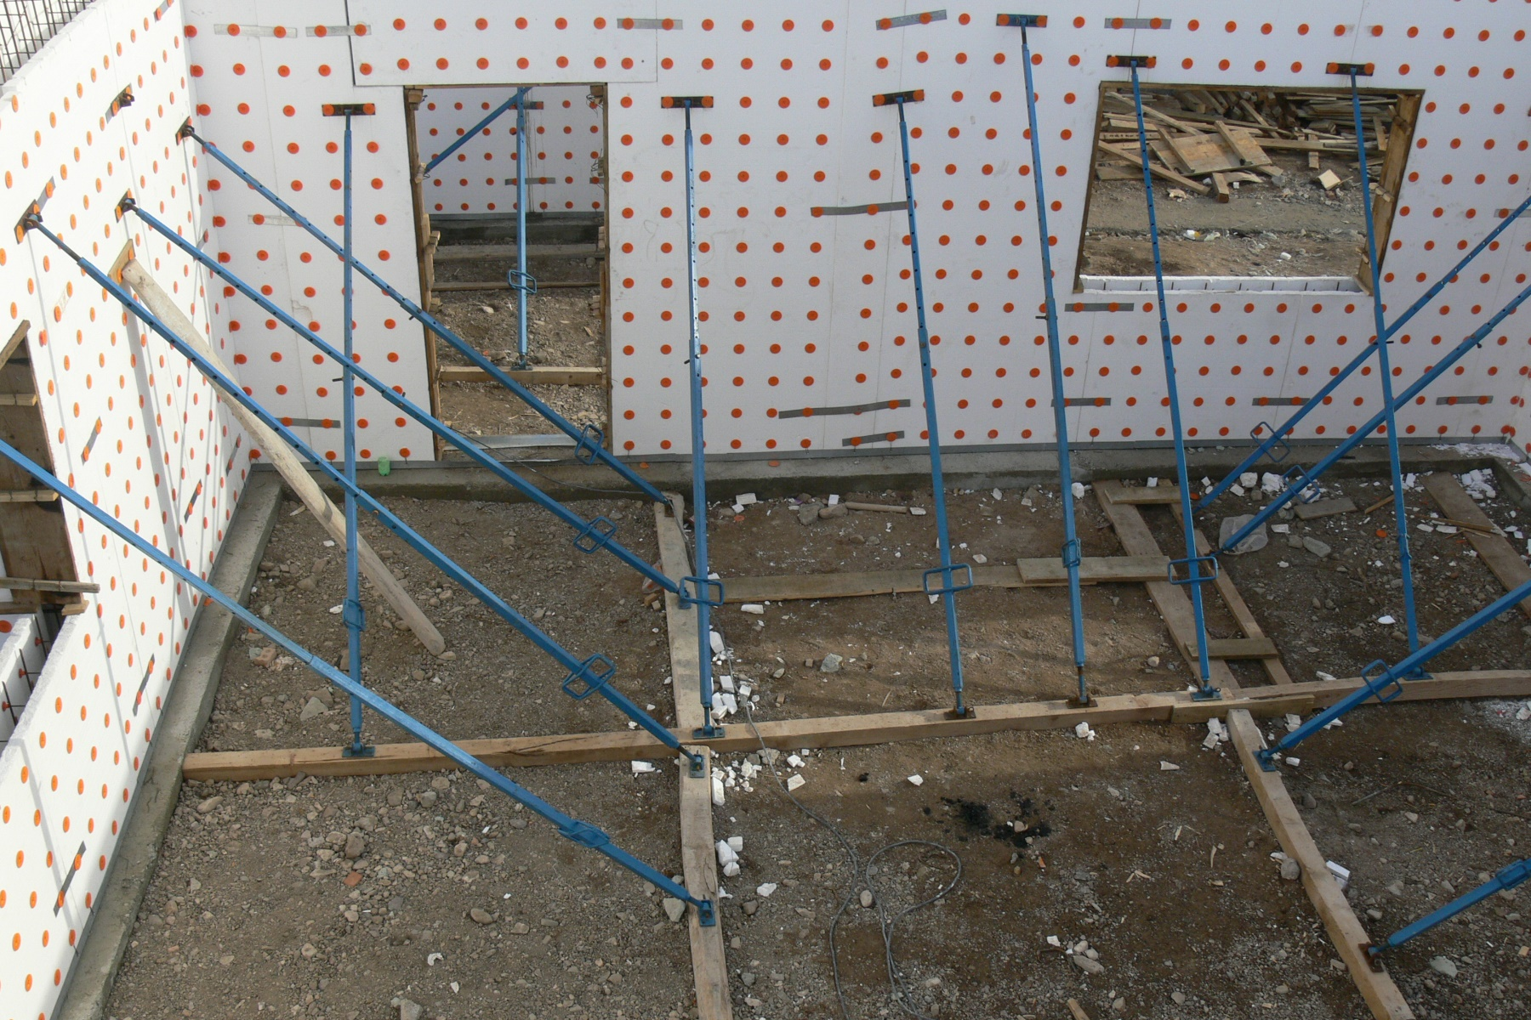
Qazvin 1386

Slide 20
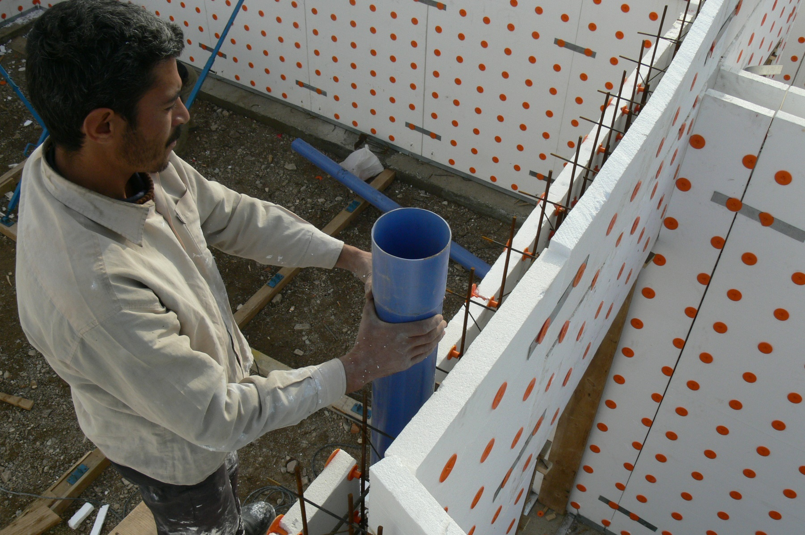
Qazvin 1386

Slide 21
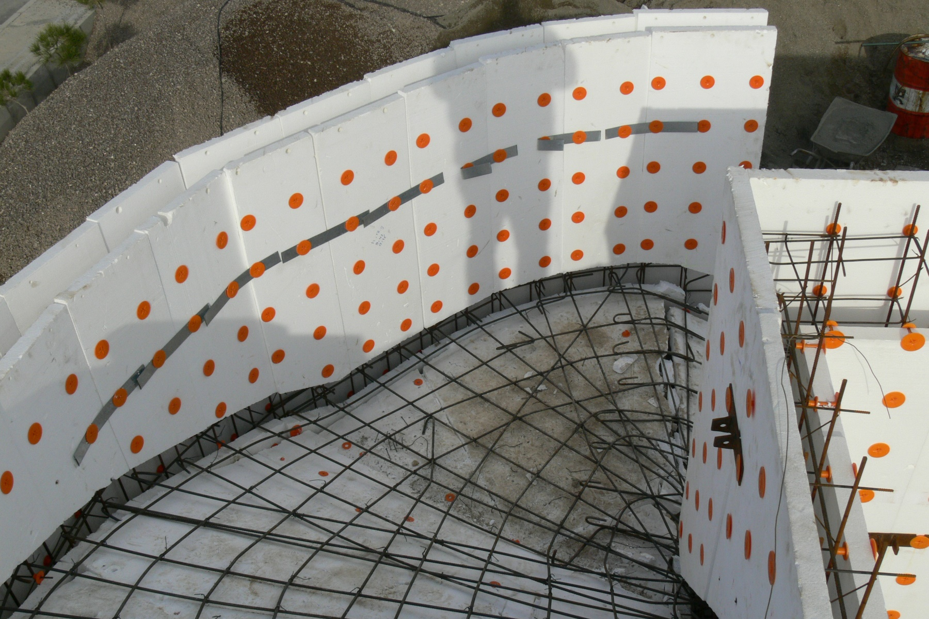
Qazvin 1386

Slide 22
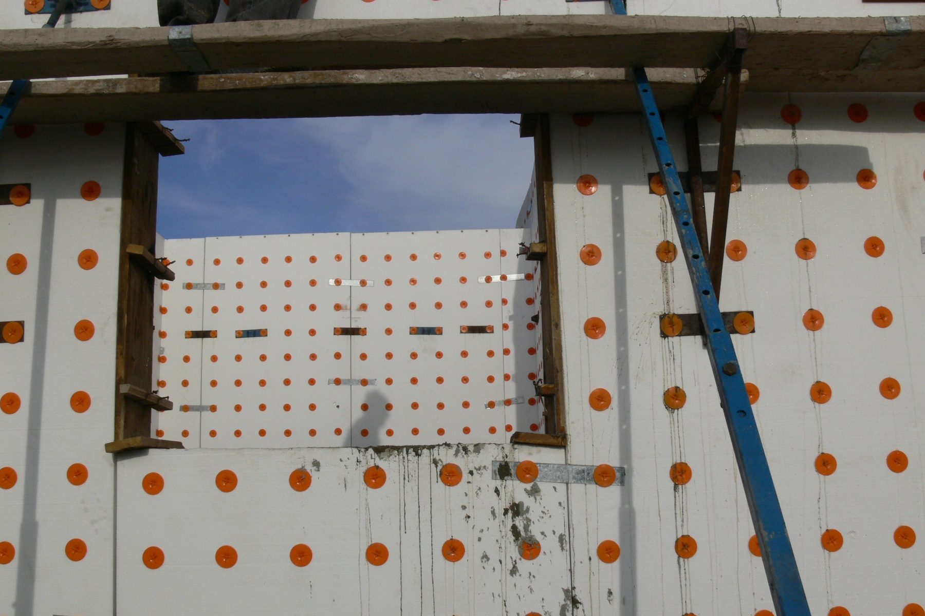
Qazvin 1386

Slide 23
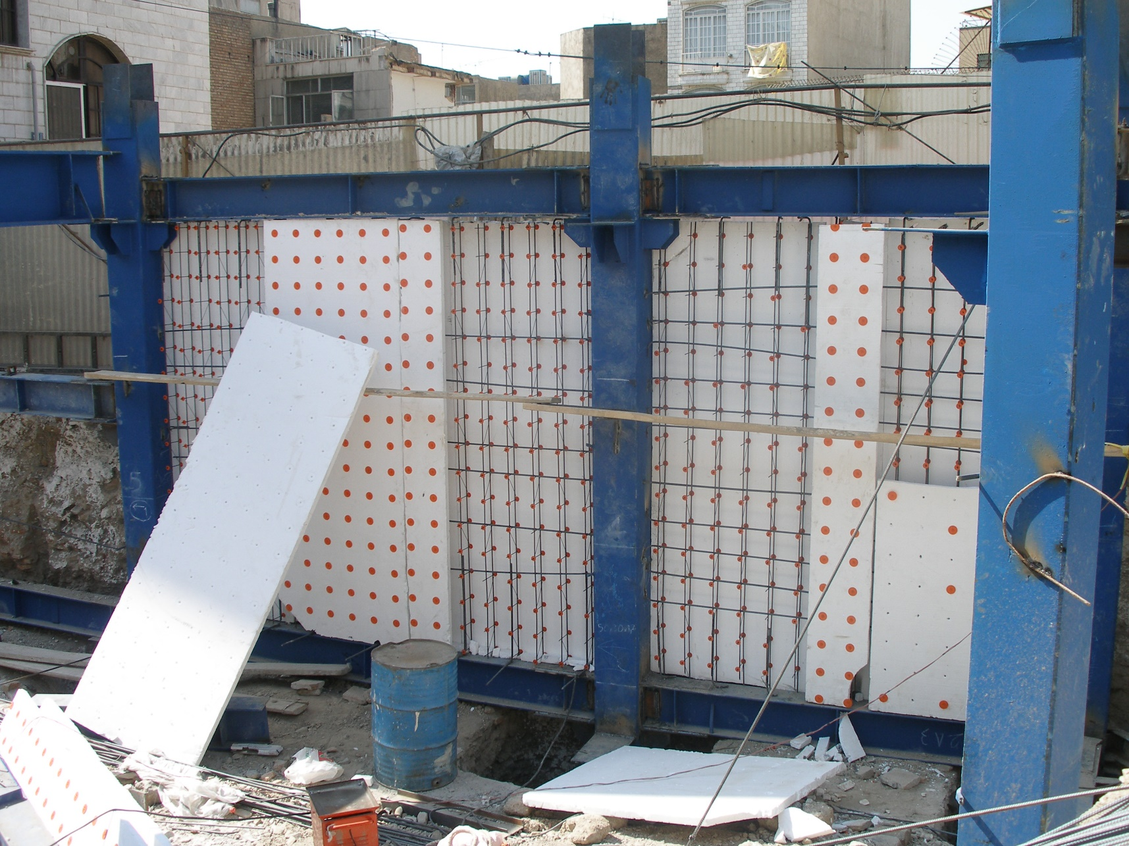
Tehran 1386

Slide 24
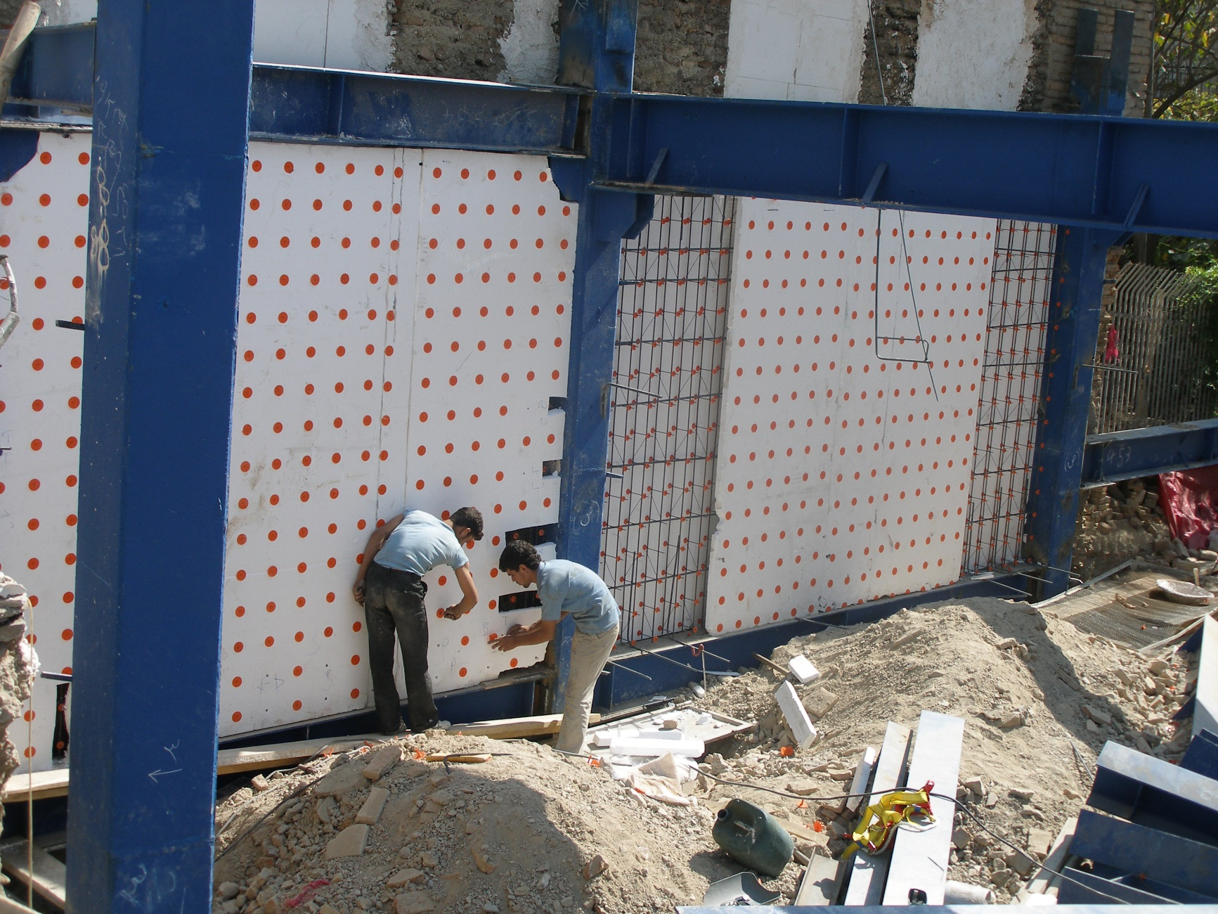
Tehran 1386

Slide 25
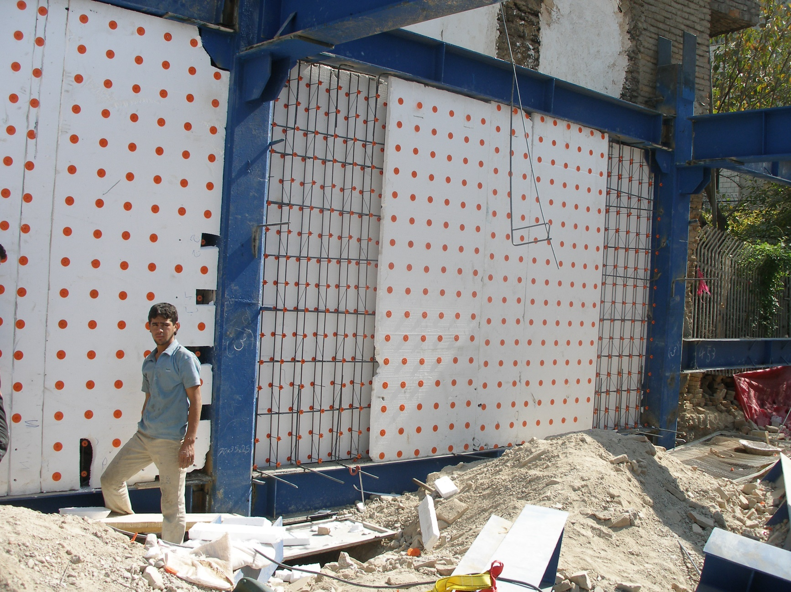
Tehran 1386

Slide 26
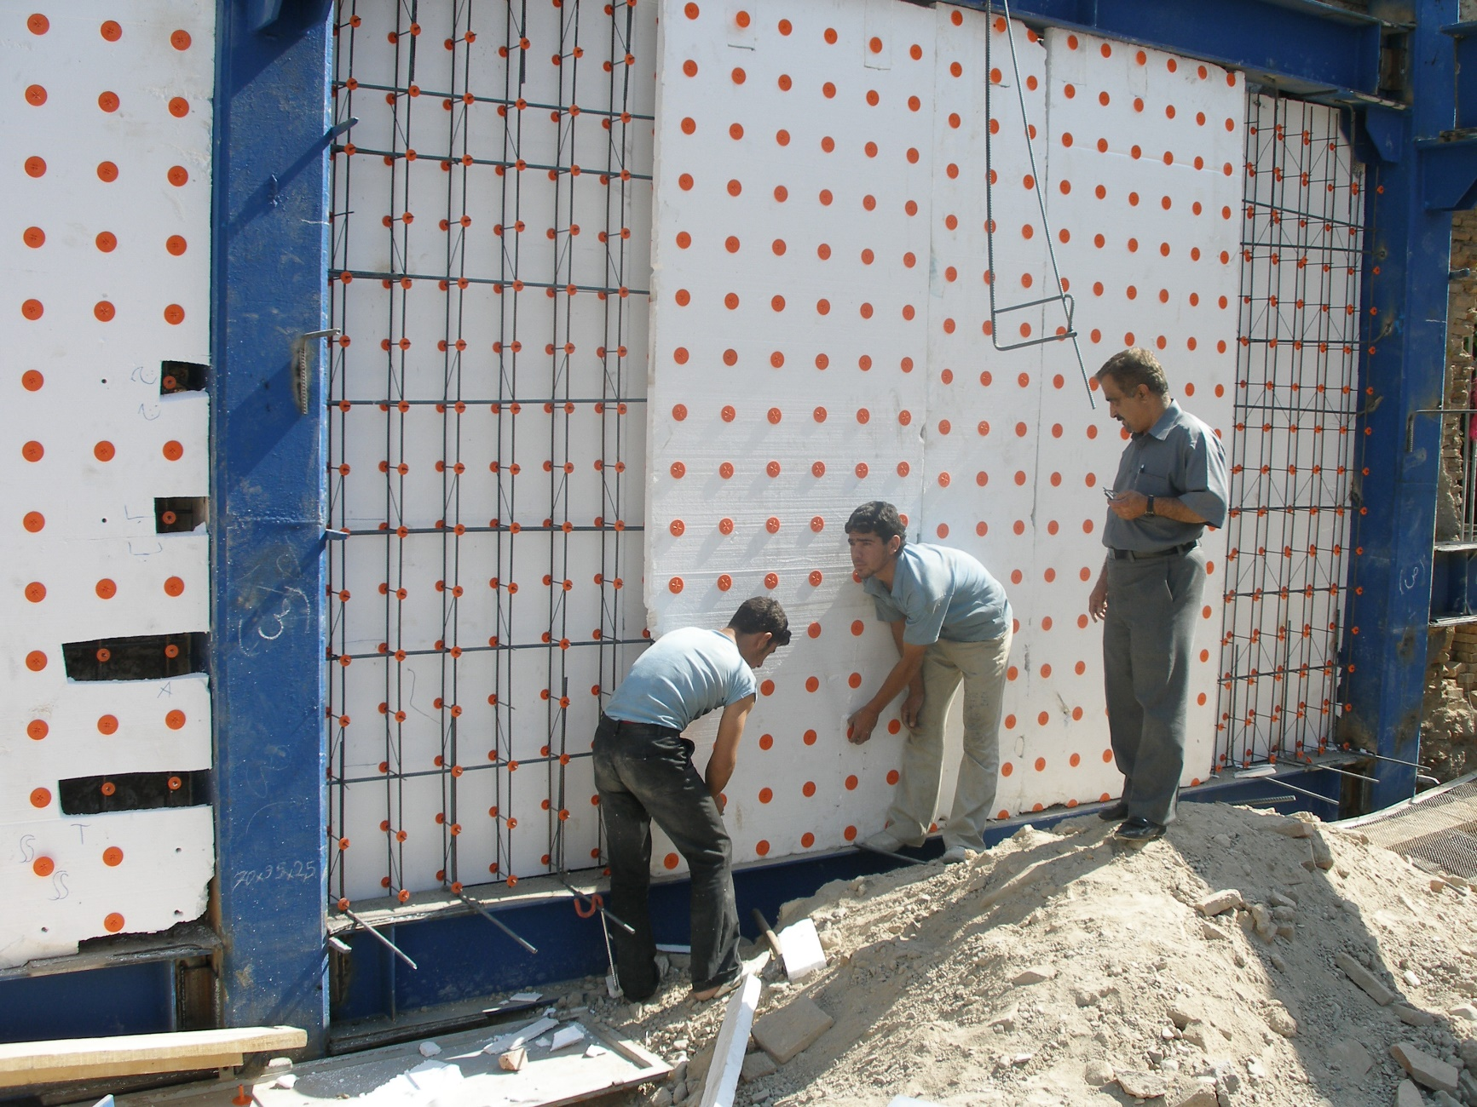
Tehran 1386

Slide 27
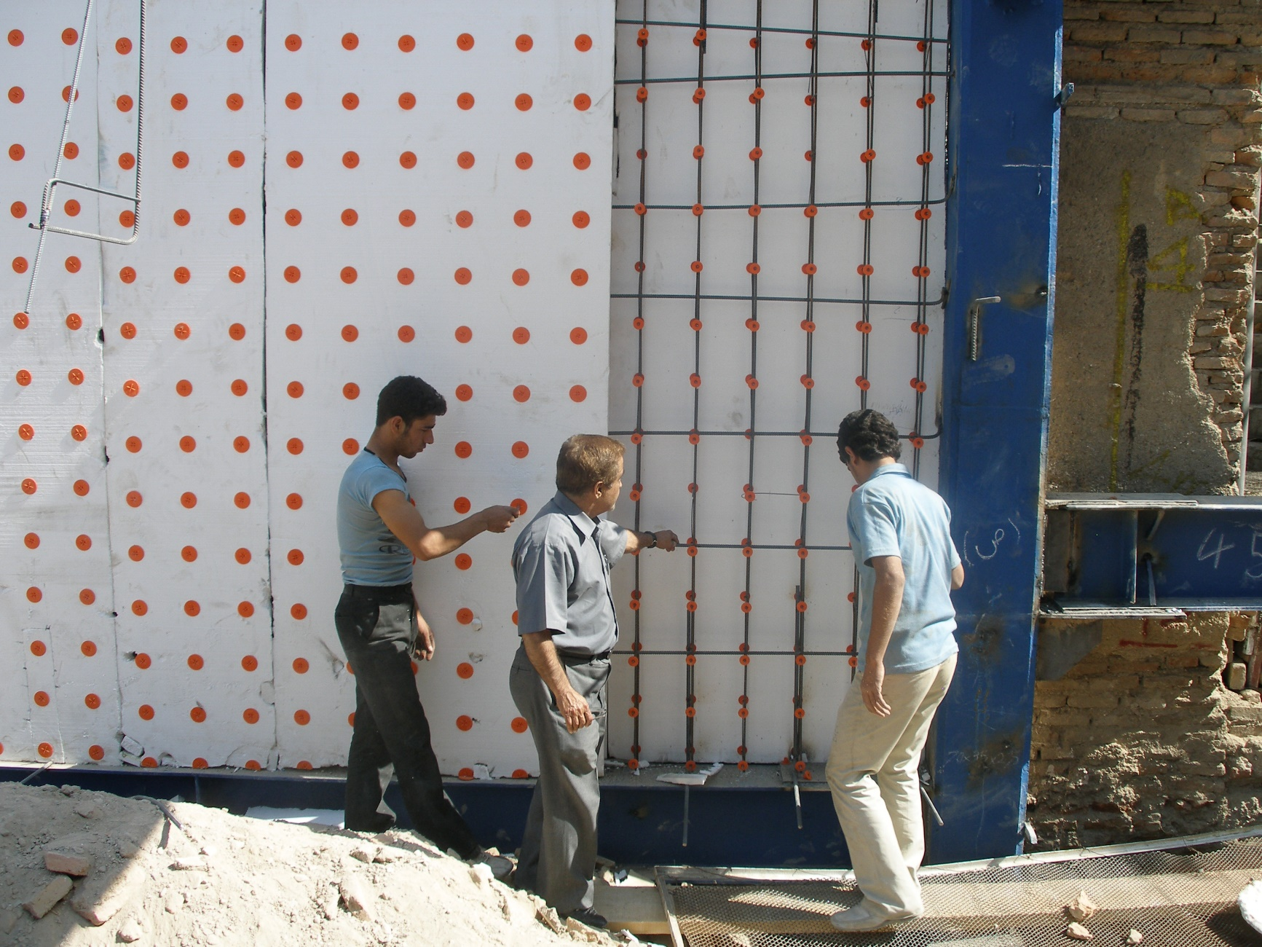
Tehran 1386

Slide 28
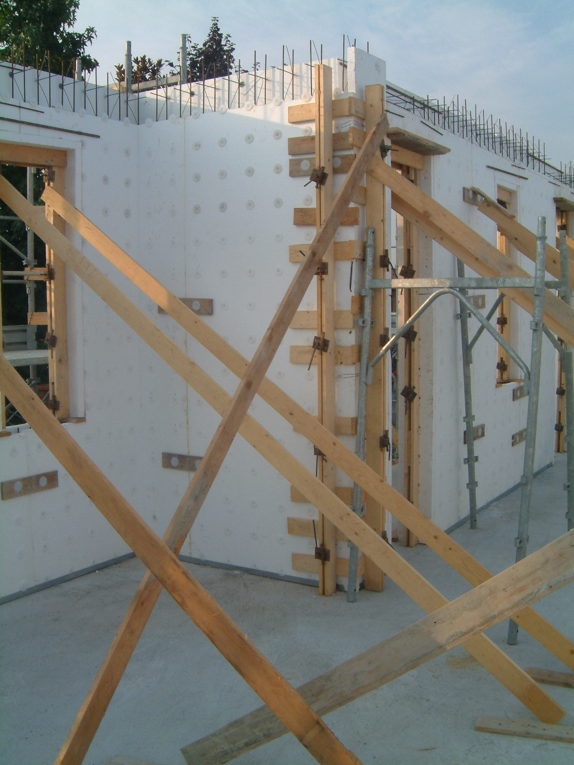
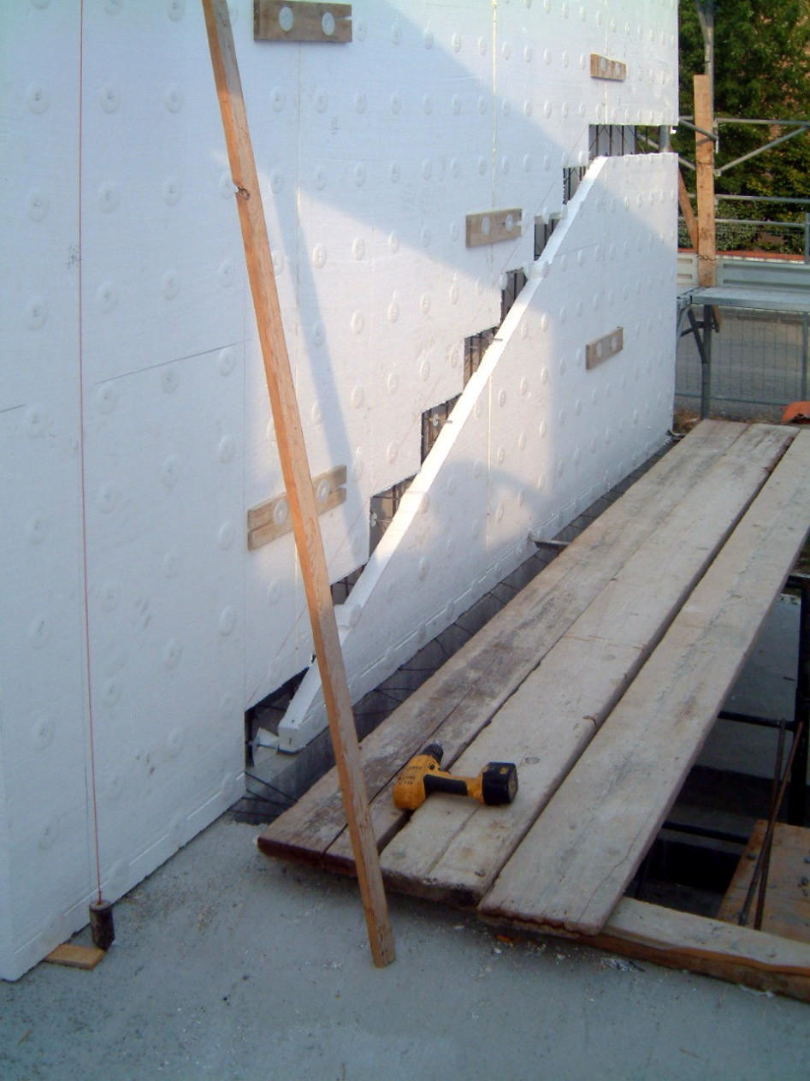
Italy 2005

Slide 29
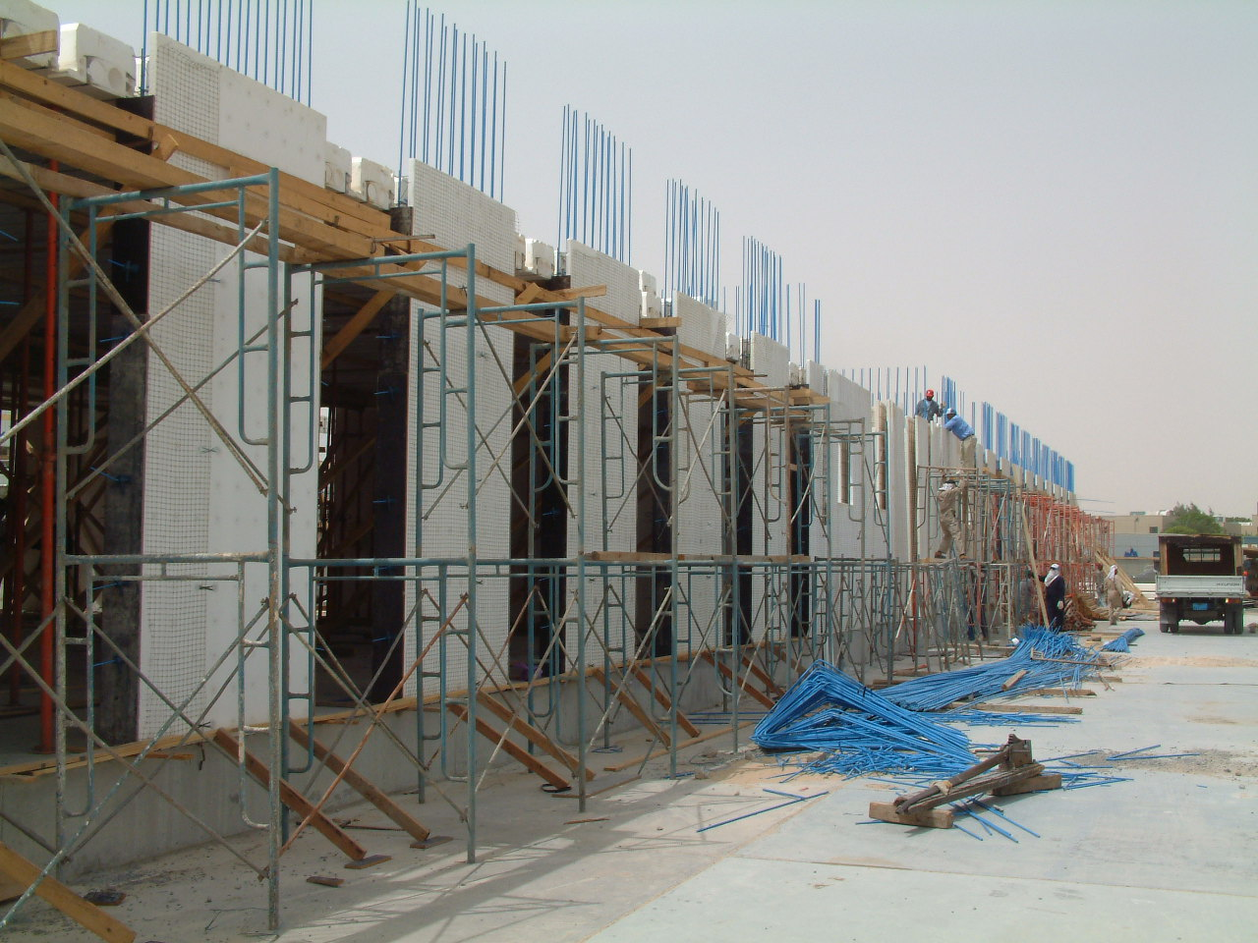
Saudi Arabia 2003

Slide 30
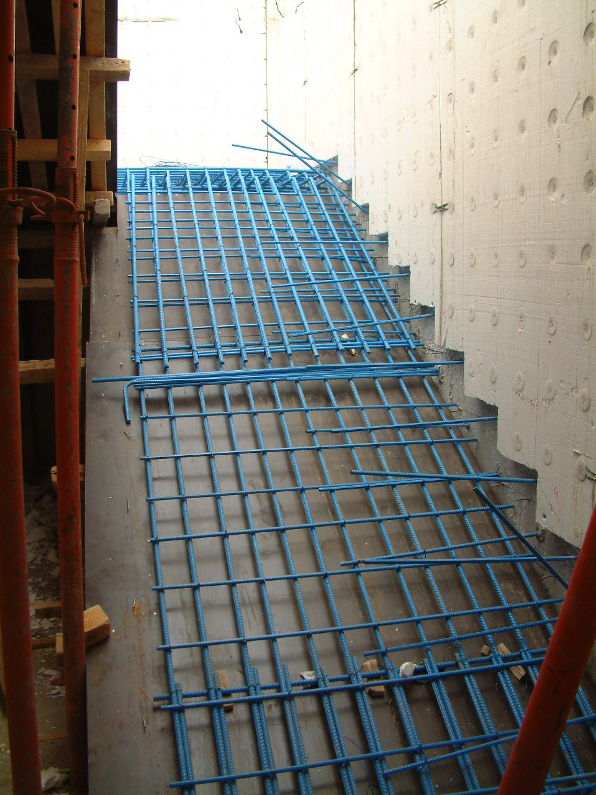
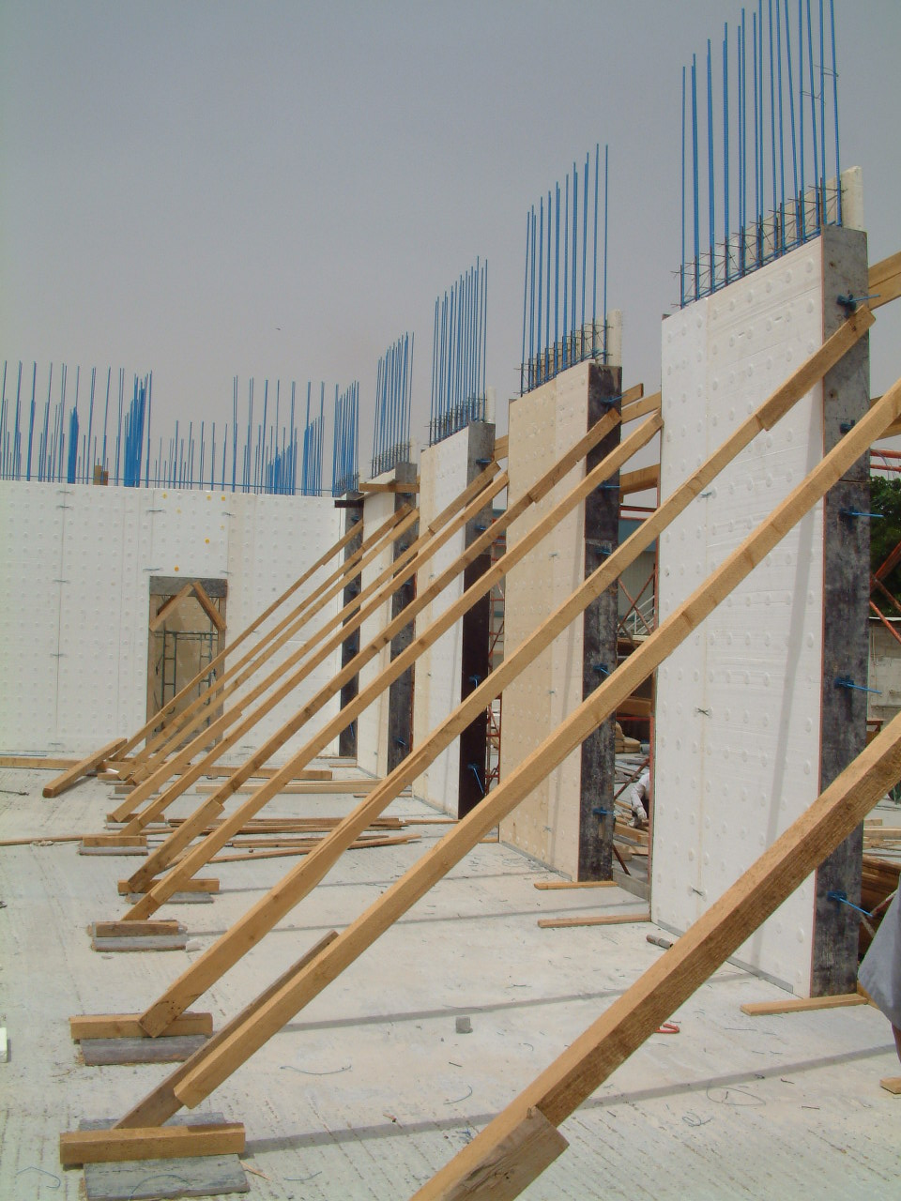
Saudi Arabia 2003

Slide 31
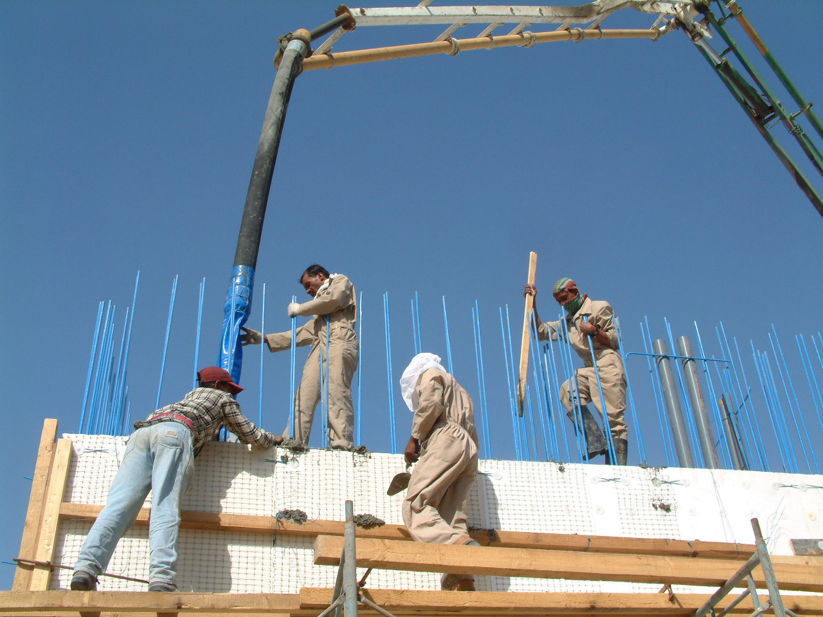
Saudi Arabia 2003

Slide 32
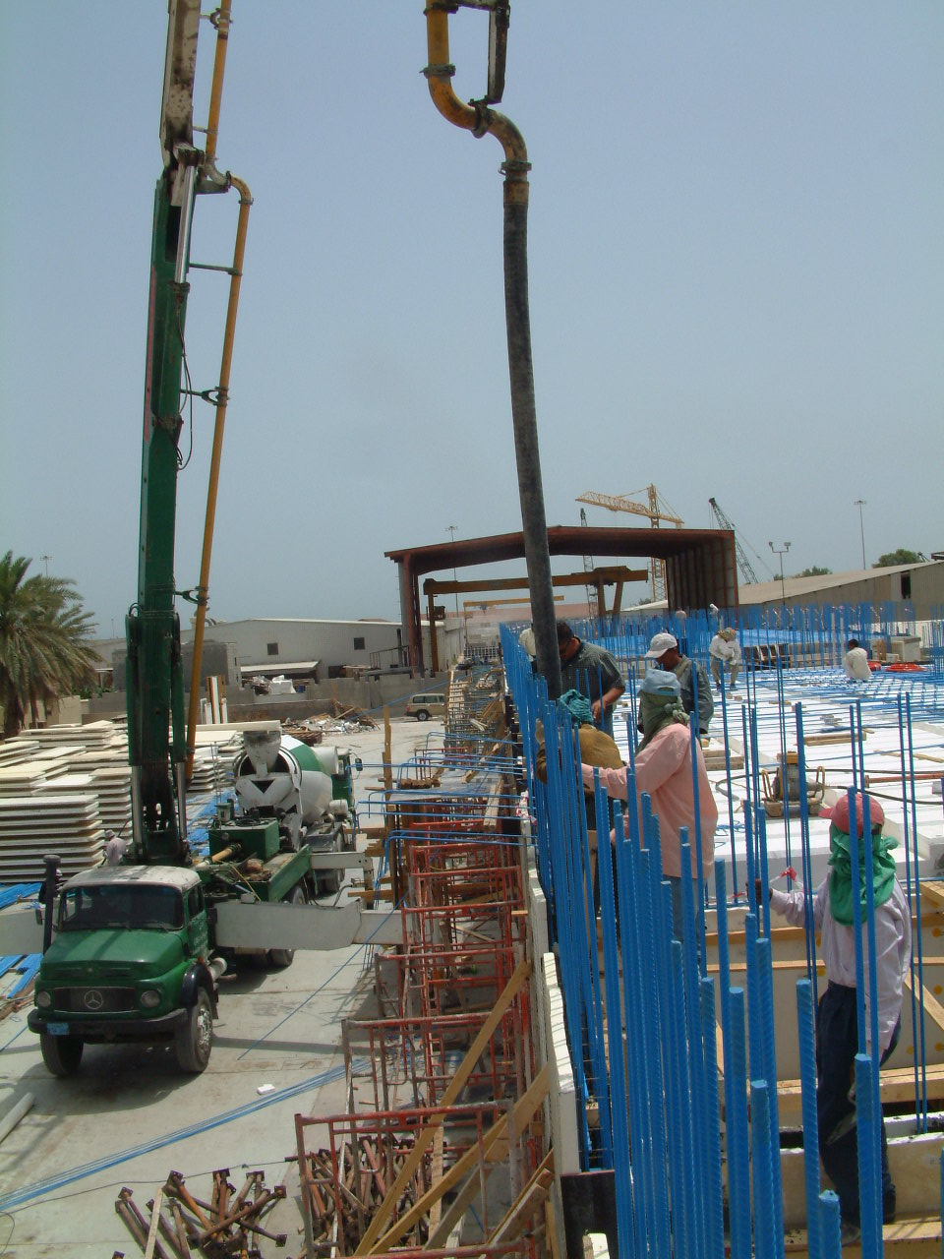
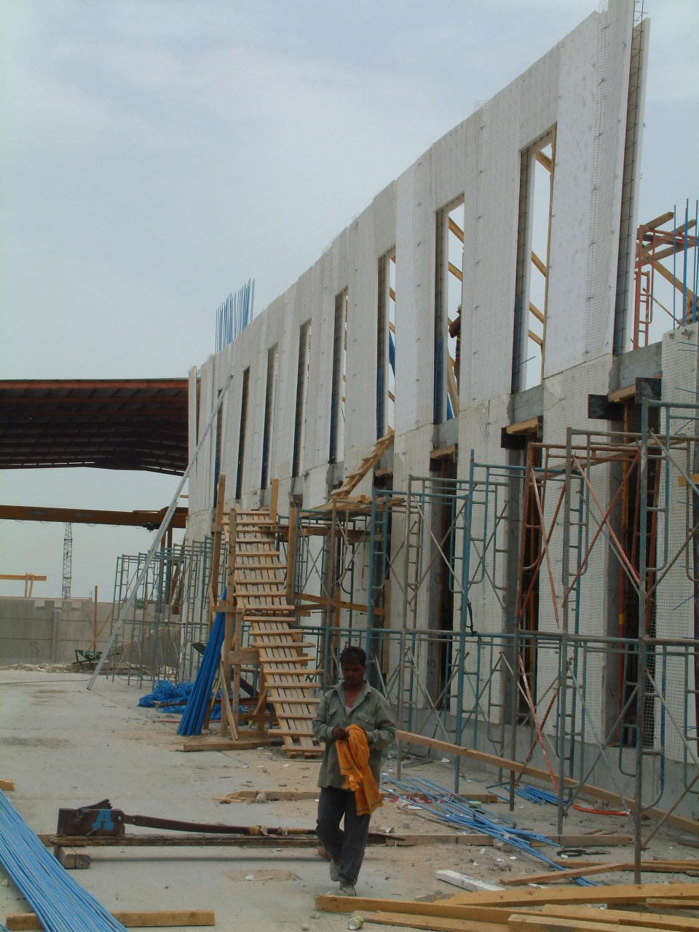
Saudi Arabia 2003

Slide 33
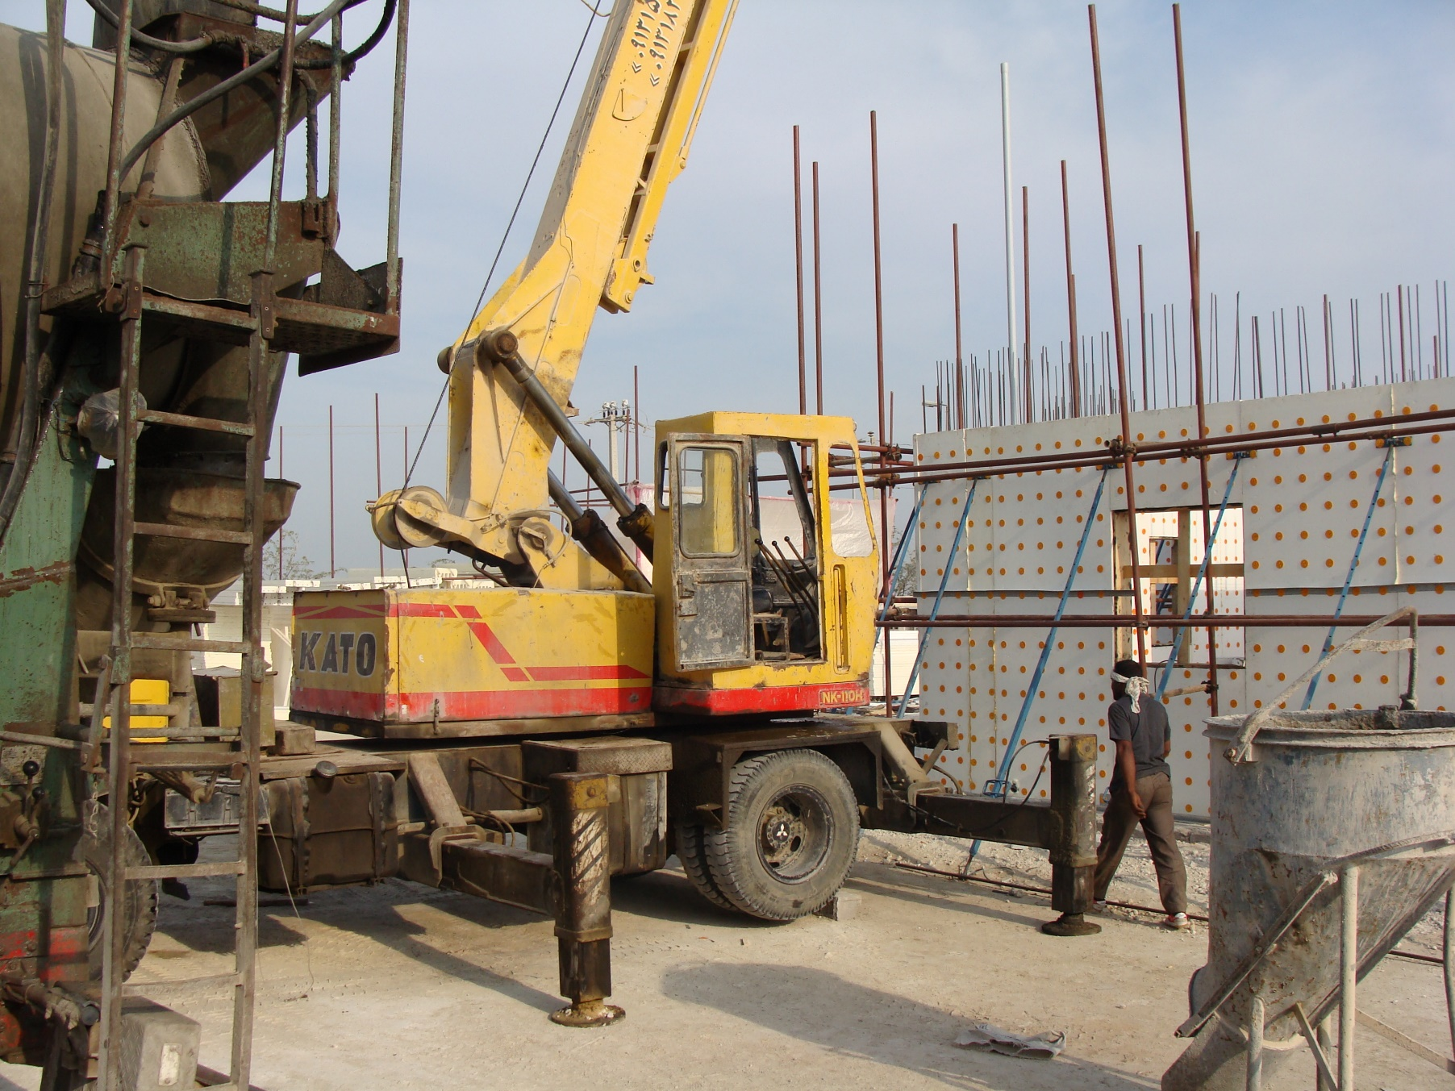
Qeshm 1386

Slide 34
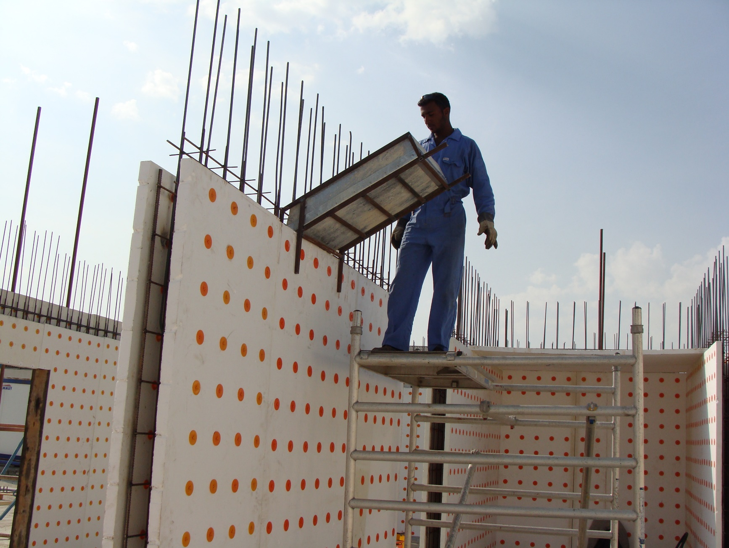
Qeshm 1386

Slide 35
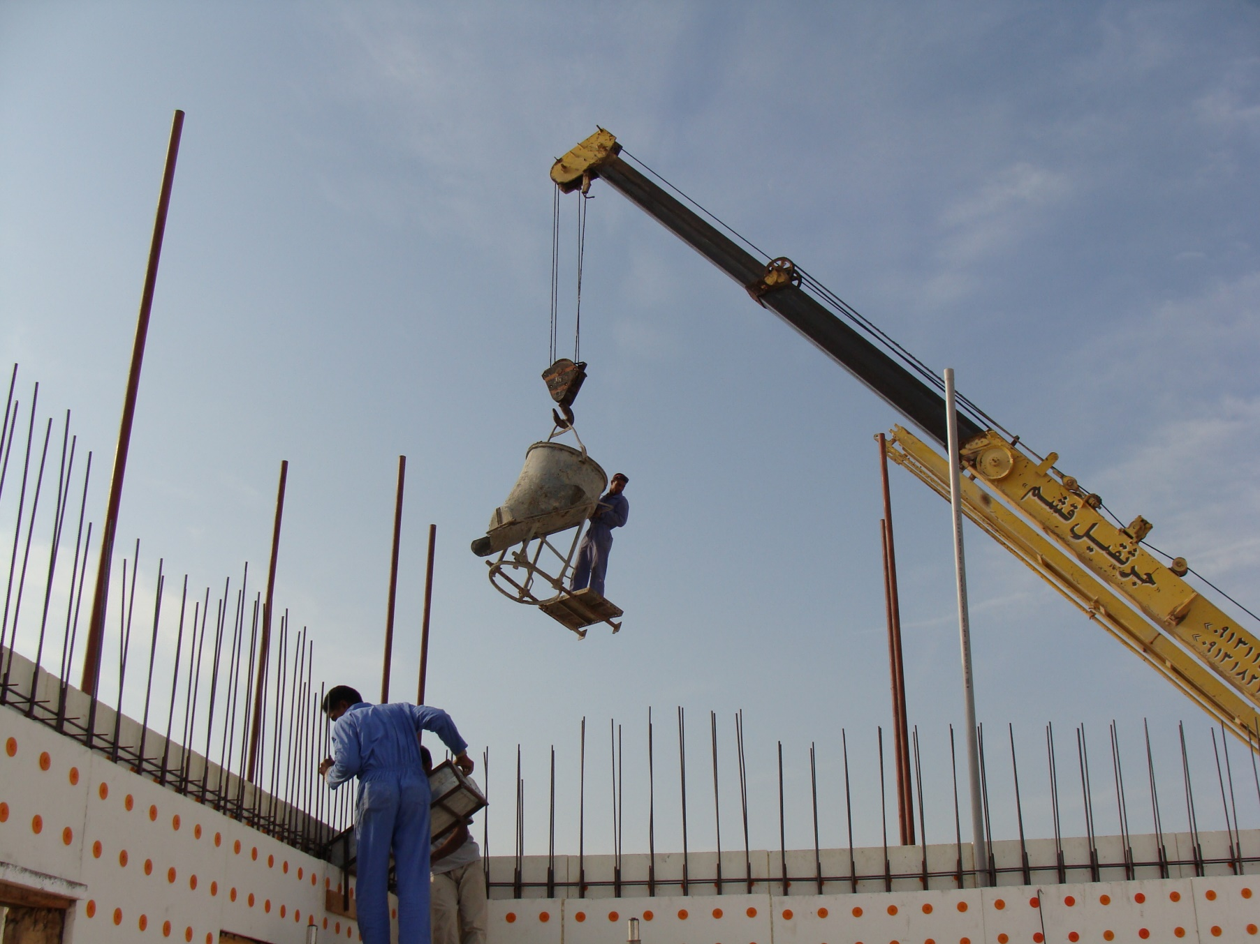
Qeshm 1386

Slide 36
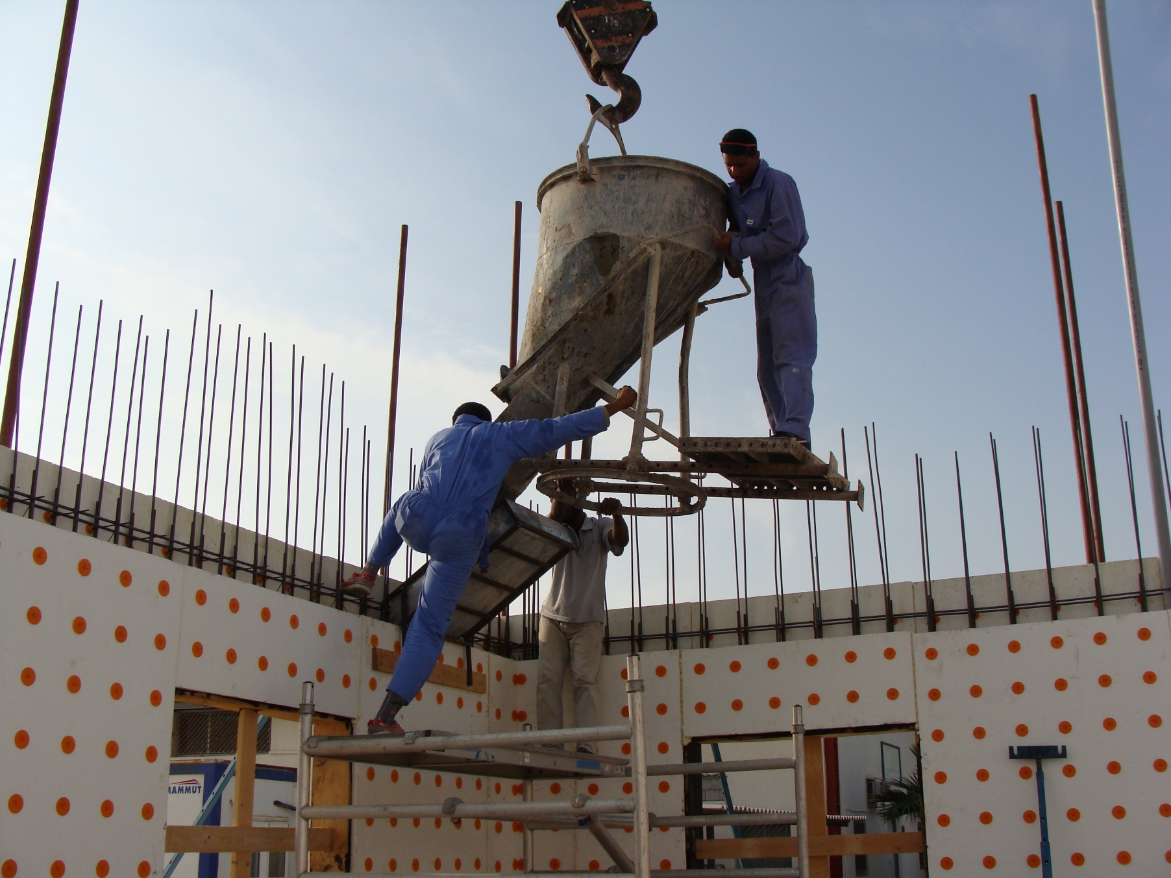
Qeshm 1386

Slide 37
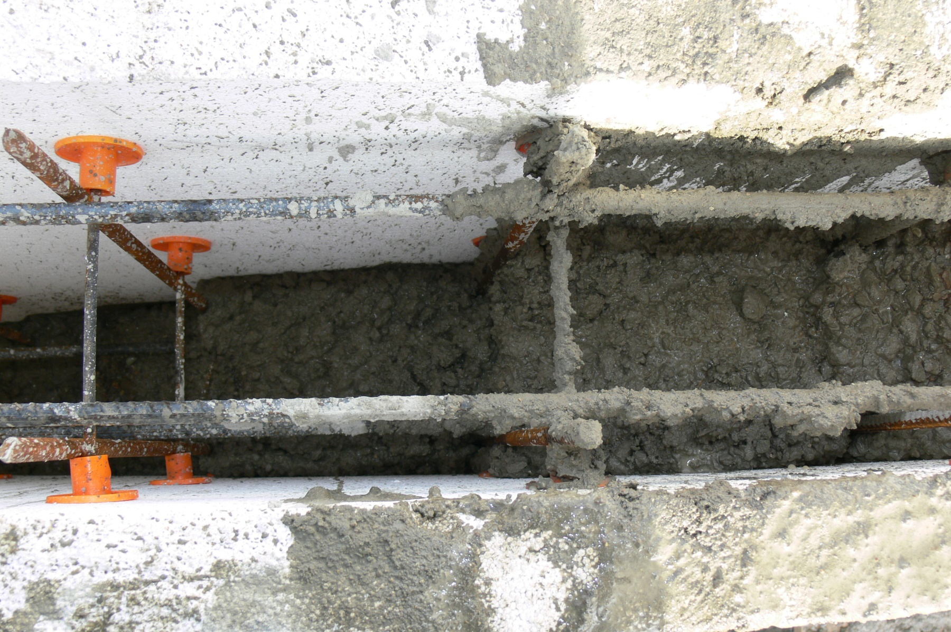

Slide 38
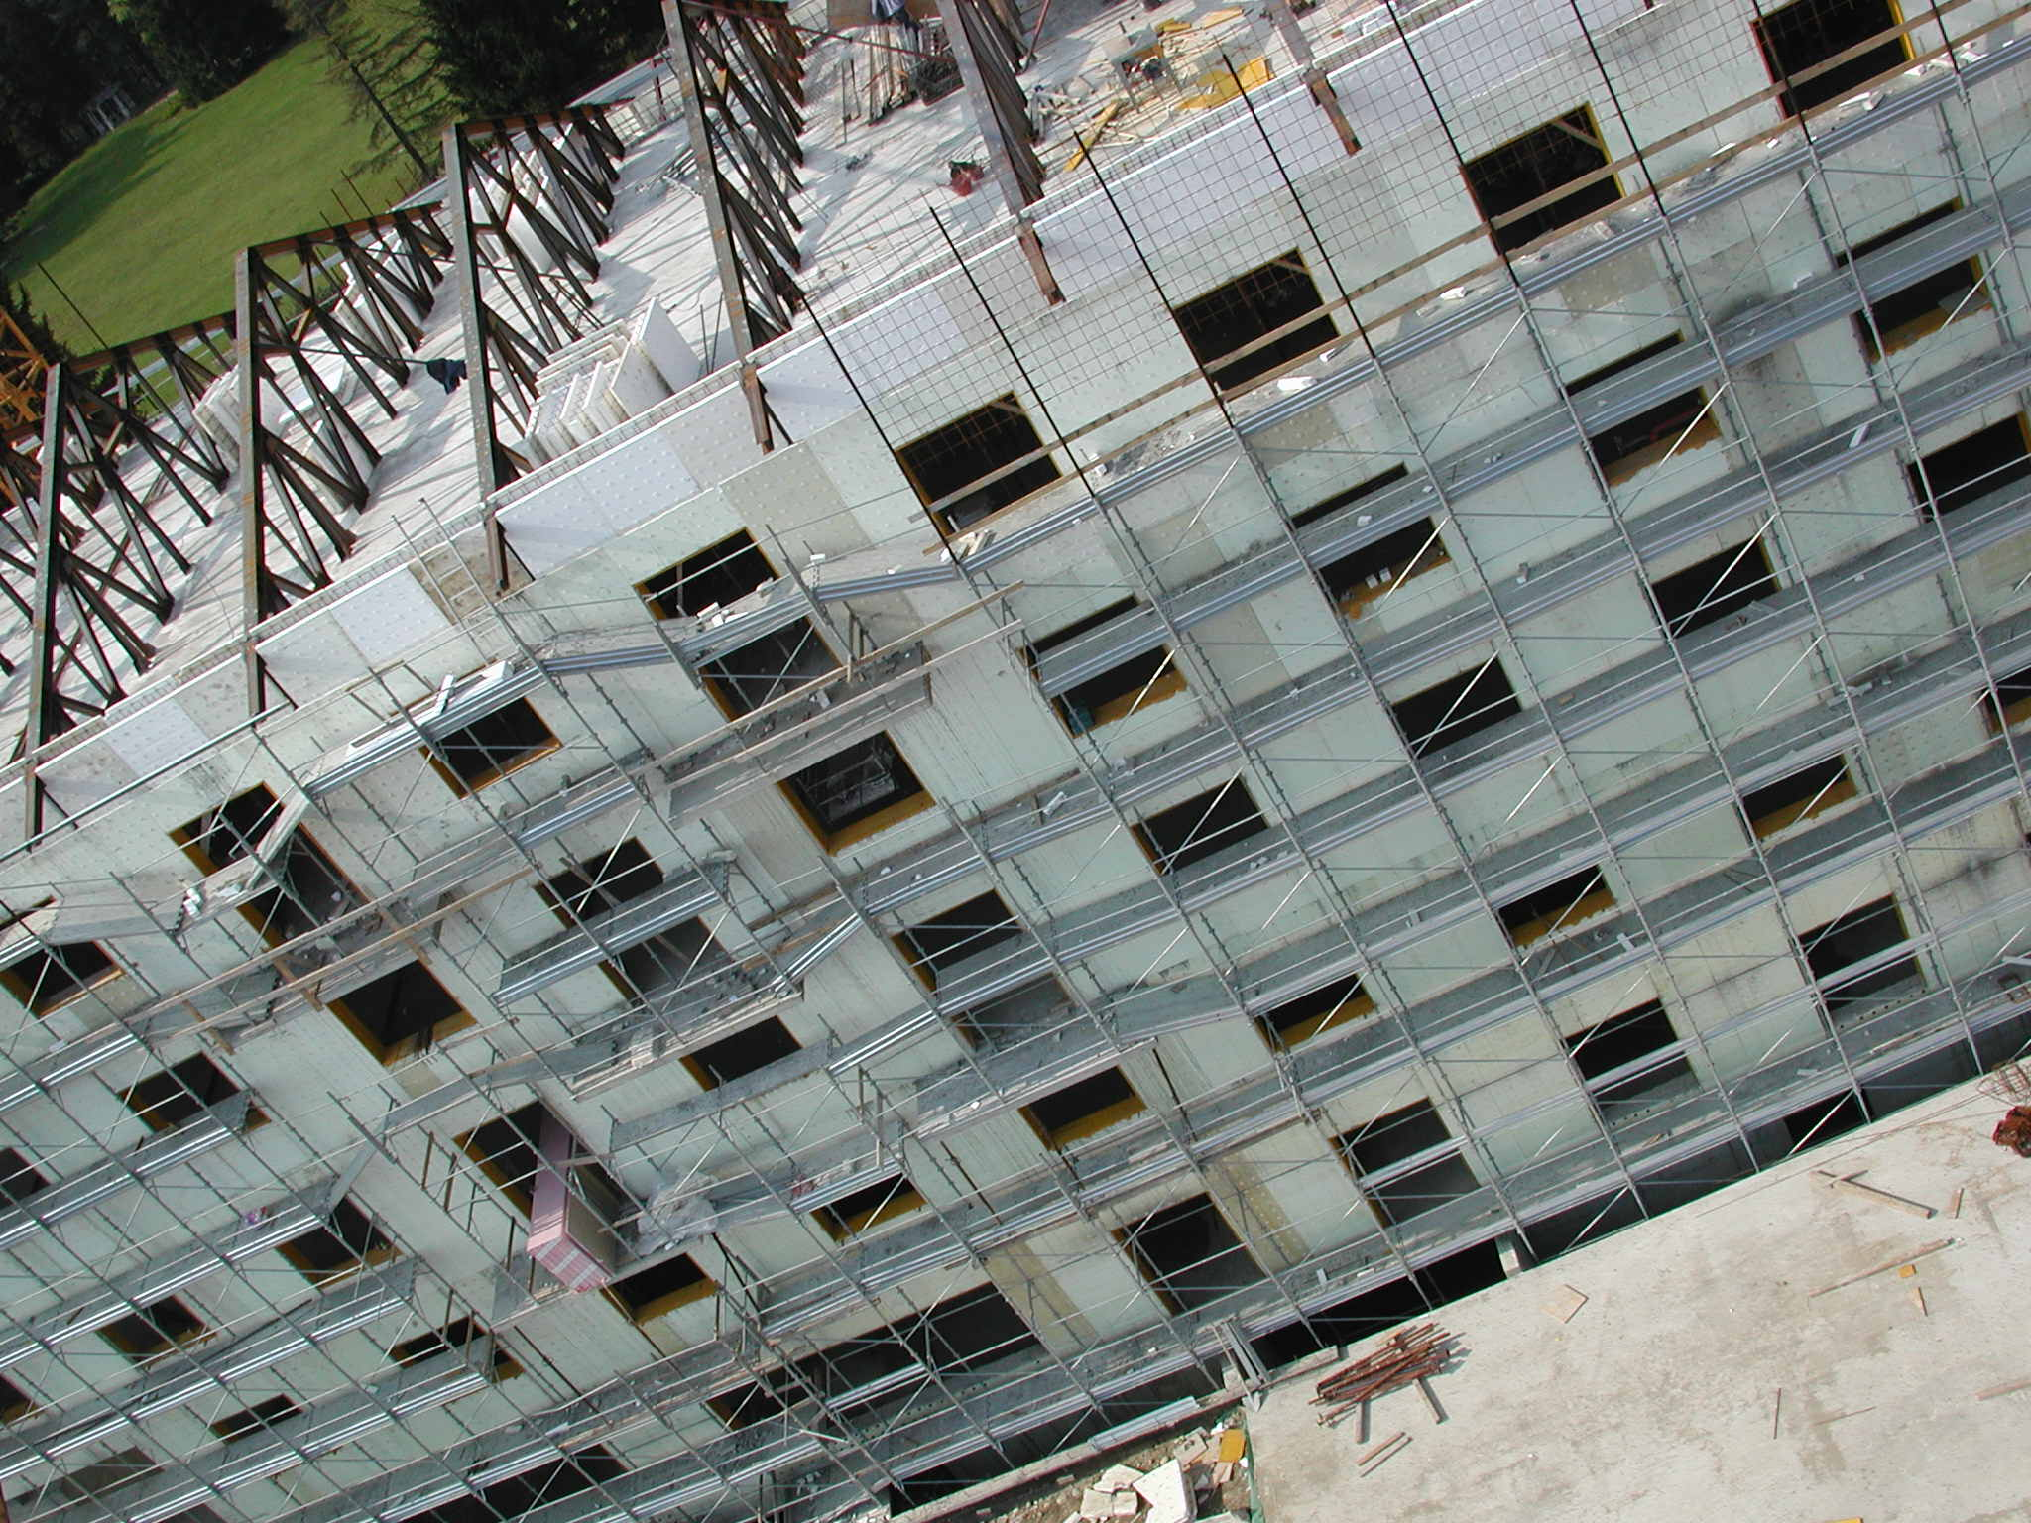
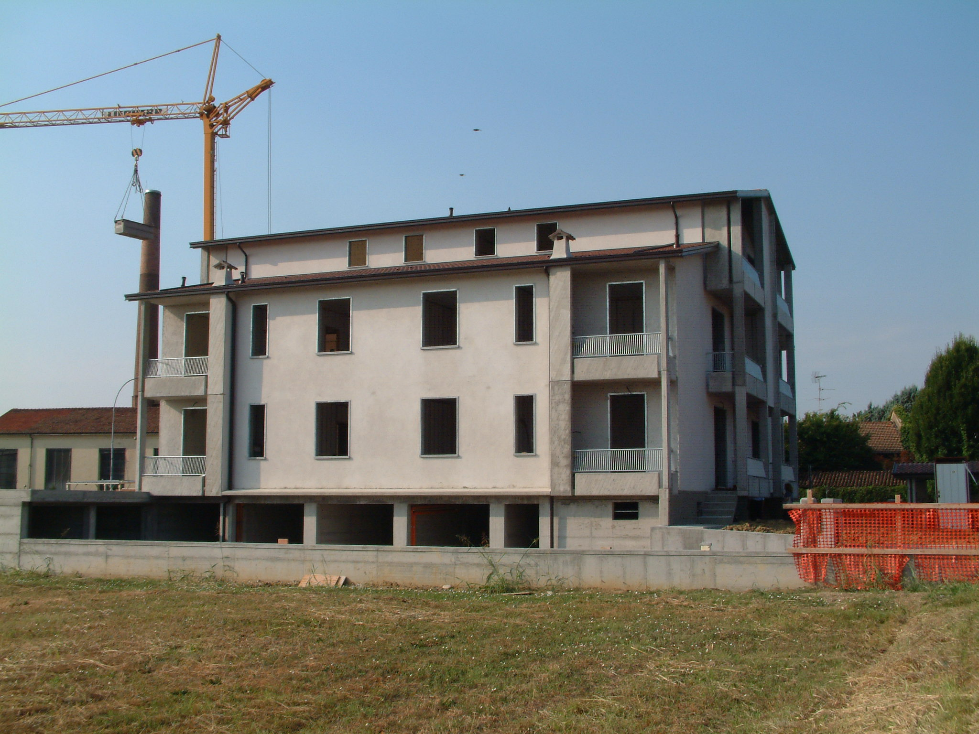
The fast, flexible and safe method to build a concrete floor or roof and wall that saves labor, time and money
WWW.SUPERPANELCO.COM

